Slide 1
Vietnam War

Slide 2
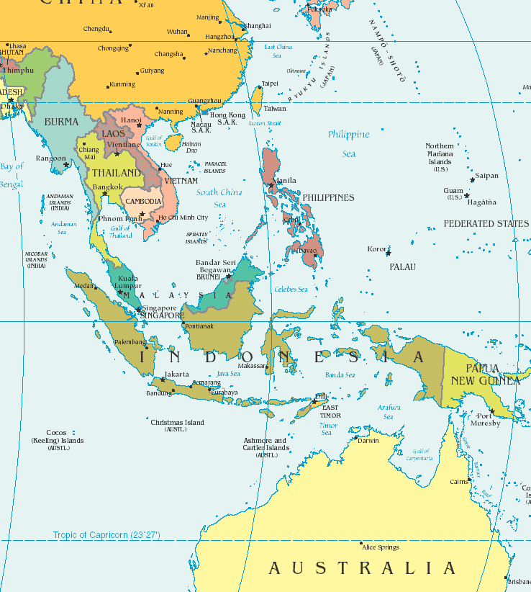

Slide 3
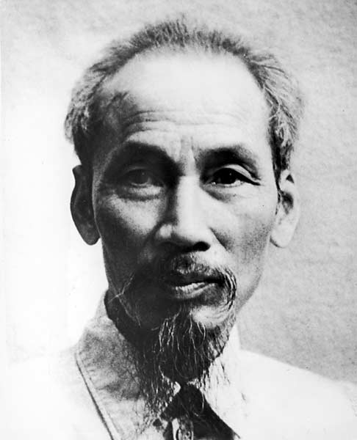
I. Why America Got Involved
A. Domino Theory & Southeast Asia
1. D-theory: One country goes commie, then rest
fall like dominos.
2. China in ’49. Now Vietnam, Laos, Cambodia?
3. Ho Chih Minh: Wants Vietnam to go Commie
Notes:
Just like with Korea, the reason we got into Vietnam was to stop the spread of communism. Domino Theory is the phrase of the time, as explained in slide.

Slide 4
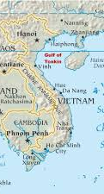
II. Gulf of Tonkin Incident
2 US Navy destroyers were patrolling the Gulf off coast of N. Vietnam and were attacked with torpedoes (missed).
Johnson then asks Congress to allow him to take “all necessary measures … to protect the United States and to prevent further aggression.”
Congress says yes, basically handing over its power to the President to wage war. As a result, the U.S. never officially declared war in Vietnam.

Slide 5
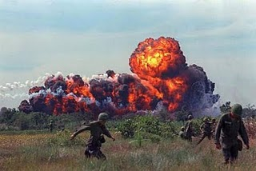
III. Frustrating War for America
A. A hidden enemy
1. Guerrilla tactics…”blend in”
2. US tries to counter, bring enemy into open
A. Agent Orange (defolliate)
B. napalm (burn everything)
Notes:
Vietnam War was fought, again, mainly by the VC in South Vietnam and they used guerrilla tactics. Hit and run, ambush, booby traps.
Agent Orange and napalm were weapons we used to try to clear out the jungle so they couldn’t hit there. Orange would be sprayed over an area of jungle and it killed all plant life, so the jungle would literally wilt to nothingness. Napalm is jellied gasoline and burns everything.

Slide 6
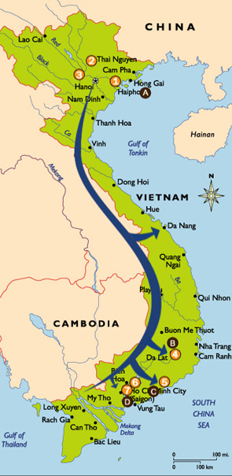
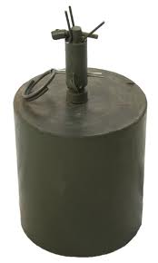
3. Ho Chi Minh Trail
A. Cambodia and Laos
4. Difficult to win
A. China aiding N.V., so we stayed limited.
B. Limitations made hard to win
5. IEDs
A. “Bouncing Betty
6. Tunnels (30k miles)
“You can kill 10 of my men to every one I kill of yours, but even at those odds, you will lose and I will win.”
-- Ho Chi Minh
Notes:
HCM Trail: supply line from North going through neighboring countries Laos and Cambodia to get goods, weapons, support to the VC in the south. Went through those neighboring countries b/c it was safe. US was not authorized to attack people in Laos and Cambodia, b/c going over the border would be an act of aggression toward those countries.
IED: improvised explosive device. Booby traps, basically.
The VC had over 30k miles of tunnels dug throughout S. Vietnam, so they could use those to hide in and travel in underground.
Following slides show tunnel system and various booby traps VC used.

Slide 7
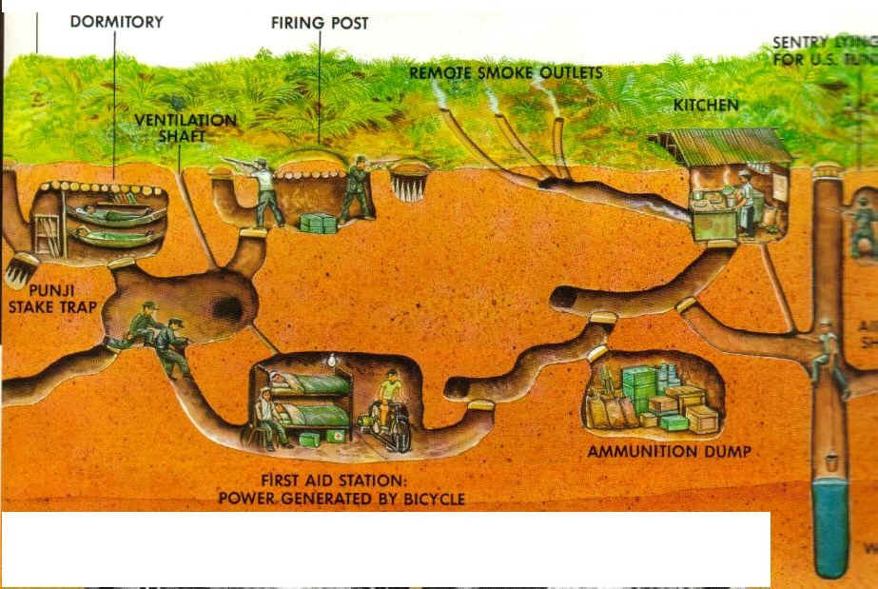
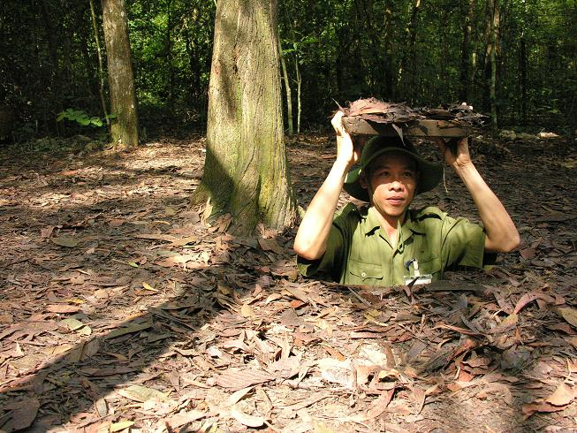
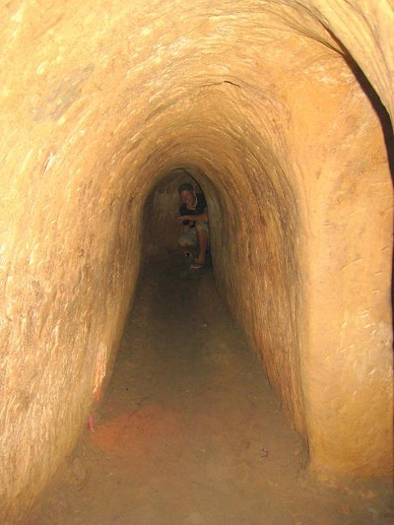
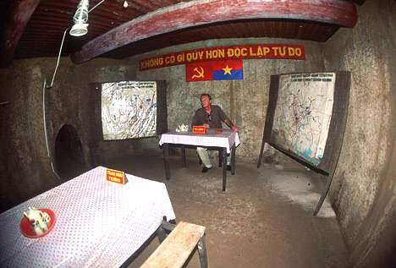
TUNNEL SYSTEM

Slide 8
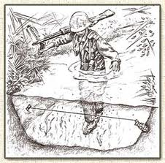

Slide 9
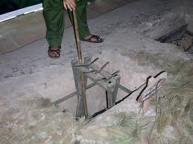
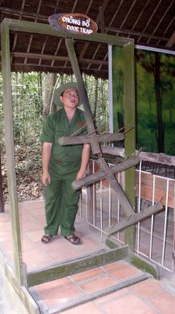
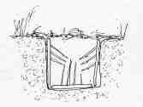

Slide 10
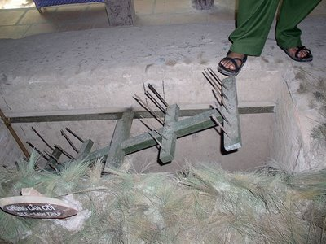

Slide 11
1968: A Year of Tragedy
US History
Notes:
Worst year in US history in the last 50 years of 20th Century. In addition to what you’re about to see about Vietnam War related tragedies, also see MLK Jr and Robert Kennedy (JFK’s little bro and presidential candidate) assassinated.

Slide 12
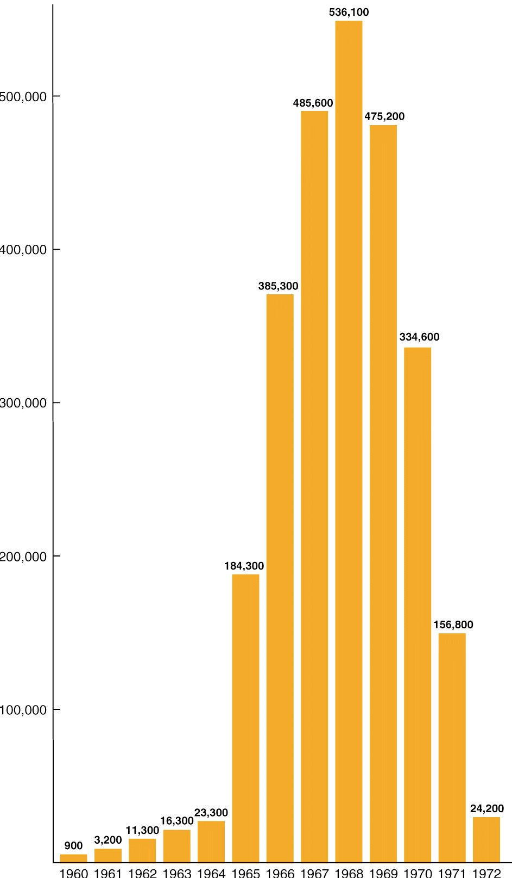
U.S. Troop Levels in Vietnam

Slide 13
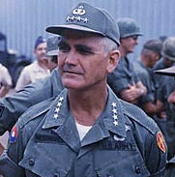
I. “Credibility Gap” emerges
A. U.S. people begin to distrust gov’t account of how war is going
B. William Westmoreland: head US General
1. Said everything great, end is near
2. Media/TV said different
a. known as “credibility gap”
C. TET Offensive
1. Jan. ‘68: North attacks EVERY U.S. base in
South on same day. NVA huge loss of life.
2. But was PR victory for N.V. → US citizens shocked
Notes:
Slide explains it.
Cred. Gap: means there’s a gap between what the gov’t is saying and what is found out to be true. Gov’t is losing its credibility with the American people.

Slide 14
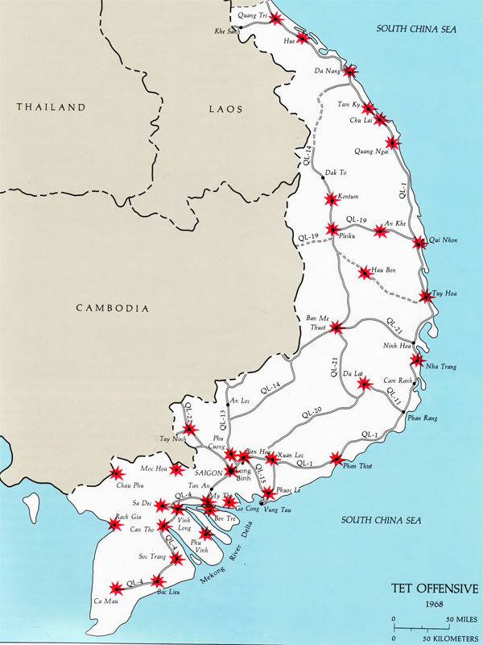
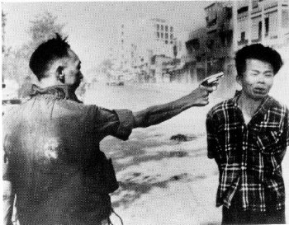
Notes:
Map of TET and pic of a S. Vietnamese general executing an “accused” member of the VC. Shocked the American people b/c we believe in due process of law. If accused, you are put on trial to prove your innocence or guilt. This kid didn’t get that chance. So people begin to wonder if we should be fighting FOR the type of people who would just execute people on the street.

Slide 15
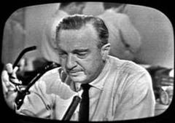
“What the hell is going on? I thought we were winning the war!”
-- Walter Cronkite, CBS News
“If I’ve lost Walter, then it’s over. I’ve lost Mr. Average Citizen.”
-- President Lyndon B. Johson
Notes:
Cronkite was seen as America’s consciencnous. Everybody watched the news with him on it every night. He was like your grandfather. What he believed, america believed.
After this, Johnson decides not to run again for president in the fall of ‘68.

Slide 16
Nixon Years: 1969-1974
US History
Notes:
Republican Richard Nixon wins election of 1968 EASILY

Slide 17
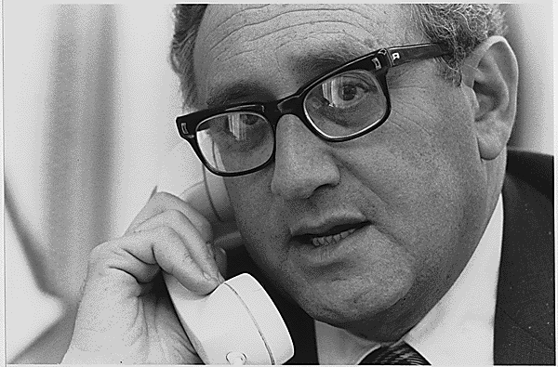
I. Nixon Moves to End the War
A. Detente
1. Peace talks w/ China
and Soviets
B. Vietnamization
1. gradual withdrawal
2. hand over to S. Vietnamese
Notes:
Détente: theory that if we can improve relations with China and USSR (the big dogs of the commie block), then they will give less support to Vietnam and that will allow us to seek and find a peace and extract ourselves from what had become an unpopular war in the US.
Vietnamization: the gradual handing over of responsibility for fighting the war to the South Vietnam army. Allow us to draw down our troop levels in Vietnam and eventually leave. Same thing currently doing in Afghanistan!

Slide 18
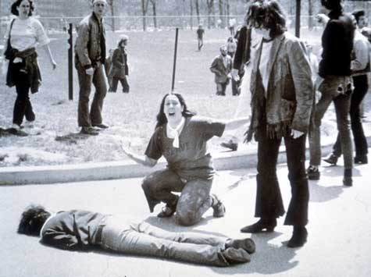
II. Turmoil at Home Continues
A. Invasion of Cambodia (April ’70)
1. Public saw this as widening war
2. 4 Dead in Ohio (Kent State)
3. 2 killed at Jackson State
Notes:
Nixon, though, decides to expand war into Cambodia to attack Ho Chi Minh Trail sights. He’d run his campaign saying he WOULDN’T expand the war. Upset a lot of people and a lot of protests started breaking out, especially on college campuses.
Biggest tragedy happened at Kent State Univ. in Ohio where the Ohio National Guard soldiers fired into a crowd of protesting students, killing four (two of who were not part of protest, but were simply walking across campus to lunch after classes). Mr. Rustay was there and witnessed it! Great song by Crosby, Stills, Nash and Young about it called “Ohio”. Ask your parents, they’ve probably got it somewhere.
A few weeks later, same kind of thing happens at Jackson State in Mississippi. Two killed there.

Slide 19
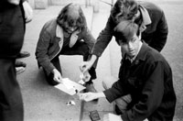
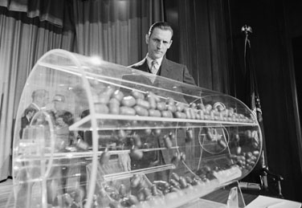
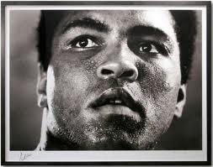
B. Draft and deferments
1. students dodge draft
a. Leave country
b. Enter college to get deferments
c. conscientious objectors
d. refused to register/burned draft cards
2. 50,000 per month drafted in ‘67
3. burden falls on poor/minorities
Notes:
As war loses popularity, more and more draft-eligible men find ways around getting drafted and being sent to a war they see as unfair and stupide.
Deferment: putting off service. Could get one by going to college. Not surprisingly, this means an inordinate # of draftees end up being black or minority since most couldn’t afford to “escape” to college. At time, about 15% of Americans were black and about 25% of draftees were black. Those numbers shouldn’t be that far apart.
Conscientious objectors: object to war based on religious/moral principals. These people also known as pacifists. Would be exempted from service if that was truly a religious principle (Quakers, Mormons, etc.). Muhammed Ali refused to serve based on saying the VC had never done him wrong, so he didn’t see why he should go kill them. He was imprisoned for a time.

Slide 20
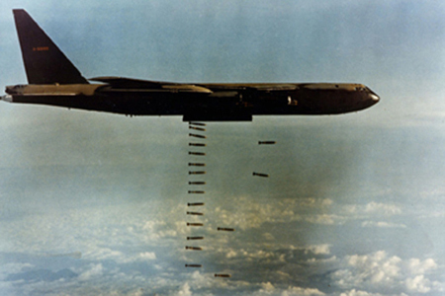
III. The US Pulls Out of Vietnam
A. 2/3 of Americans want to end ASAP (’71)
B. Paris Peace Accords (Dec. ’72 – Jan. ’73)
1. January 1973: peace agreement reached
3. NV troops remain in the South
Notes:
In 1973, we manage to work out a peace agreement that allows the US to withdrawal from Vietnam militarily. In the agreement, Vietnam remains two countries (north as commie, south as democratic), but we allow NV troops to stay in South to “police” and “secure” the country. In reality, that’s like allowing the wolf to live in the hen house to “guard” over them. You know the wolf will eventually eat them….

Slide 21
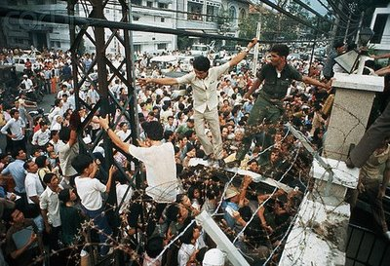
South Vietnam Falls
1. March 1975: North breaks agreement, invades
2. Congress refuses Ford’s request to aid
3. April 30th: Saigon falls, Vietnam united under communism
Notes:
… and NV does take over SV in March ‘75. By this time, Gerald Ford is president. As part of the peace agreement in ’73, we had promised the south that we would come back if NV broke promise. NV knew that wouldn’t happen b/c American people were tired of vietnam. So when Ford asks congress to allow our troops to go back to help SV survive, Congress does exactly what NV thought it would do – say no.
Saigon: the capital city of SV. Once it falls, the entire SV falls to communism. Picture is of SV citizens trying to flood into the US embassy on April 30 to seek refuge and passage to the USA b/c they don’t want to live under communism.

Slide 22
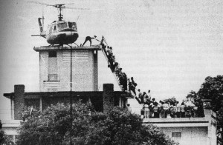
Notes:
Helicopter on roof of US embassy that would carry refugees out to US aircraft carriers. From there they would be sent to the USA and given asylum.

Slide 23
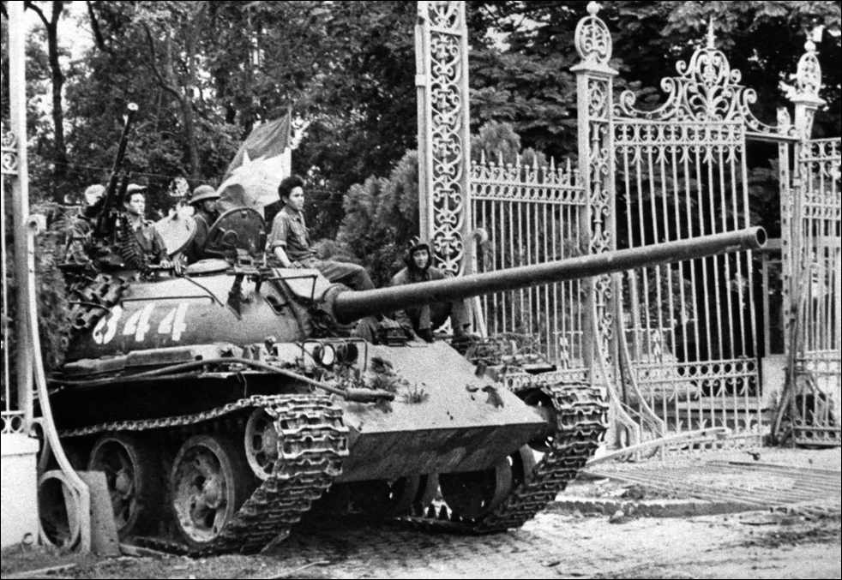
Notes:
NVA tanks rolling through gates of the SV Presidential palace.

Slide 24
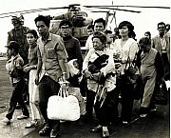
Notes:
SV refugees on deck of US aircraft carrier, with the only possessions they have left – what they could carry.

Slide 25
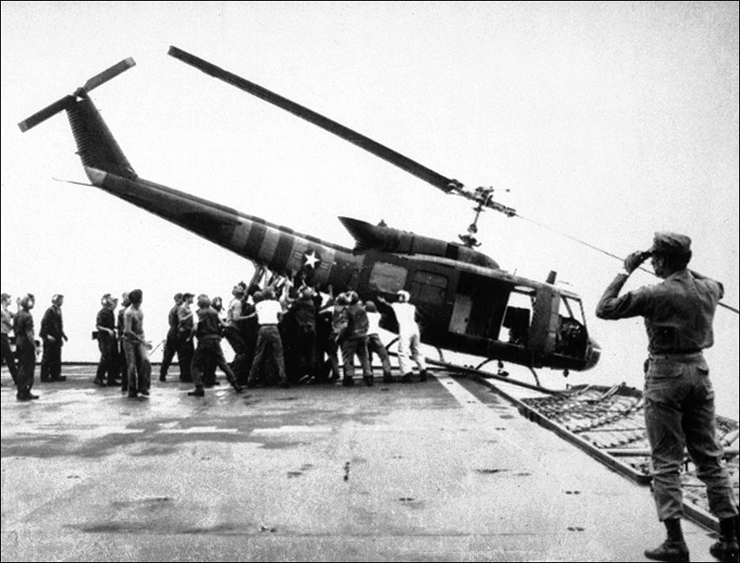
Notes:
Shoving chopper of deck of carrier to make room for next chopper coming in to land. So many choppers in the air that when a chopper had a mechanical problem or ran low on fuel and they didn’t have time to refuel, they dumped them off side. Needed deck space to land incoming choppers that were also low on fuel and needed to land ASAP.

Slide 26
The Legacy of Vietnam
A. The War’s Human Toll
1. 58,000 dead
2. 1,000,000+ Vietnamese soldiers
3. Soldiers not honored upon return
4. 1982: memorial
B. The War’s Impact on the Nation
1. War Powers Act
Notes:
Vietnam was the first war in which returning US soldiers weren’t celebrated. In many cases, they were shunned by an American public that had grown to see the war as bad. People would curse at them, spit at them, refuse them service, call them murderers and baby killers. Remember, most of the men who served in ‘Nam didn’t do it voluntarily, they were drafted. They didn’t ask for this, they simply answered the call of their nation when it called upon them to fight.
In 1982, the vietnam war memorial “The Wall” was commissioned and built in Washington DC.
War Powers Act: since LBJ didn’t actually ask congress for declaration of war, we never really were officially at war in Vietnam. Technically, it was a “police action” that was authorized under presidential authority. War Powers Act was passed during Nixon’s administration in which Congress limited the President’s ability to send US troops into fighting to 30 days. Any longer than that, congressional approval was needed.

Slide 27
Watergate: Breaking America’s Trust

Slide 28
I. What was Watergate?
Break-in during Election of 1972 at the headquarters of the Democratic Party in Washington D.C.
Authorized by underlings of President Nixon
Burglars caught, arrested. Investigation by Washington Post ties burglars back to Nixon’s White House staff.

Slide 29
II. Fall of a President
Nixon had no prior knowledge of plan.
He did authorize cover-up in attempt to cover his butt and protect friends.
Exposed when one of burglars flips and tells all
C. Watergate Tapes: Nixon bugged own office
Senate demands tapes, Nixon refuses: Executive Privilege.
Supreme Court rules Nixon must turn over tapes
Notes:
B is the reason Nixon got in trouble and would have to eventually resign.
Executive privilege: right of president to withhold things that concern national security.

Slide 30
III. Resignation
Aug. 8, 1974: Nixon resigns
Only president ever to leave office
Impeachment and removal was inevitable
Nixon pardoned by President Ford
Protects Nixon from legal prosecution
Reason: we need to move forward

Slide 31
IV. Impact of Watergate & Vietnam
These two events of the 1960s and 1970s forever changed the way the American public viewed our national government. Prior to Vietnam, the American people trusted that their government was being honest with them. Then came the credibility gap. Watergate solidified for the people that their government could be/was untrustworthy.

