Slide 2
Lesson Objective
Students will be able to identify important characteristics on a map, and be able to utilize the map scale and find the map legend

Slide 3
What is Geography?
Geography is the science that studies the earth's features.
It is learning where different countries and continents are located, what they look like, and what their climates and cultures are like.
The word geography means "description of the earth."

Slide 4
Jobs of Geographers
One of the most important jobs in geography is to describe exactly where places are located on the earth.
To do this, geographers must identify the absolute location, or the exact spot, of each place.

Slide 5
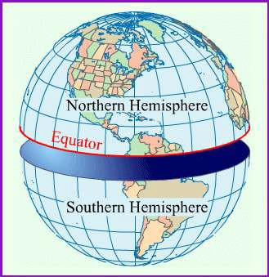
Invisible Lines
Geographers identify the locations of places by using lines of latitude and longitude.
They first locate the equator, the imaginary east and west line that encircles the earth at its widest point.
The equator is about
25,000 miles (40,000 kilometers) in length.
The equator divides the earth into the northern and southern hemispheres.
A hemisphere is half of the earth.
Most of the land areas on earth are in
the northern hemisphere.

Slide 6
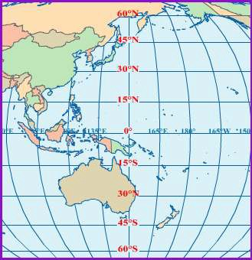
What are these Lines for?
Lines of latitude, or parallels, are imaginary lines marked at regular intervals that are parallel to the equator.
The equator itself is a line of latitude. It is marked 0° (zero degrees).

Slide 7
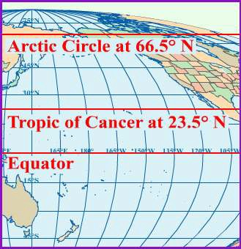
What are these Lines for?
Lines of latitude in the northern hemisphere are marked with an N, which means that the line is north of the equator.
An N indicates a location north of the equator in the northern hemisphere.
The North Pole is marked 90°N. The South Pole is marked 90°S.

Slide 8
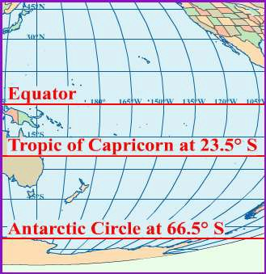
What are these Lines for?
Two special lines of latitude south of the equator are the Tropic of Capricorn at 23.5°S and the Antarctic Circle at 66.5°S.
The areas north of the Arctic Circle and south of the Antarctic Circle are cold and frigid all year because they are so far from the equator.

Slide 9
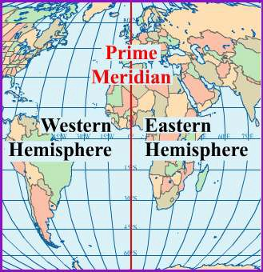
The Big Red Line
Lines of longitude, or meridians, are imaginary lines marked at regular intervals that converge at the north and south poles.
One special line of longitude is the Prime Meridian, which passes directly through Greenwich, England.
Like the equator, it divides the earth in half. The half east of the prime meridian is the eastern hemisphere, and the western half is the western hemisphere.

Slide 10
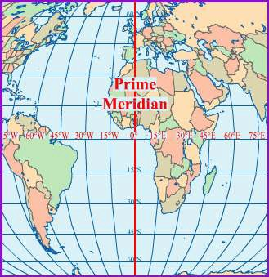
The Big Red Line
The prime meridian is the beginning place for marking locations as east or west. It is marked 0° (zero degrees). Other lines of longitude, or meridians, appear at fifteen degree intervals either east or west of the prime meridian.
Lines of longitude in the eastern hemisphere are labeled E for east, and lines in the western hemisphere
are labeled W for west.

Slide 11
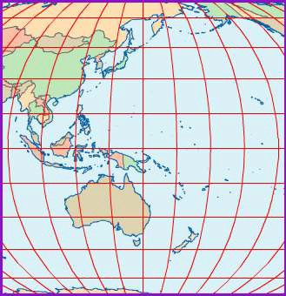
The Big Red Grid
Lines of latitude and longitude form a global grid, or a set of intersecting lines on globes and maps.
It is possible to find the exact location of places anywhere in the world using the lines of latitude and longitude on the global grid.
A location described by a precise latitude and longitude is an absolute location. A street address is also an absolute location.

Slide 12
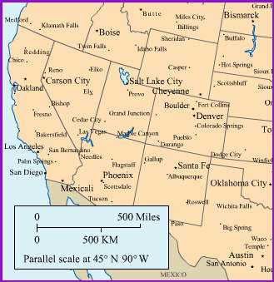
Map Scales
Cartographers are people who make maps.
They use a scale to show the relationship between the distances shown on the map and the actual distances on the earth.
The inset, or legend, of this map shows a scale.
To use a scale on a map, measure the distance between two points with a ruler. Compare your measurement

Slide 13
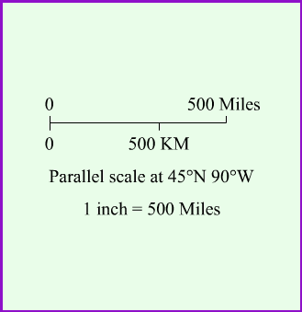
Map Scales
For example, one inch on a map can be used to show 500 miles in actual distance; however, scales can vary on maps, so be sure to note what the scale represents on each map you work with.
If a map scale uses one inch to represent 500 miles and you measure 3 inches from one point to another on a map, the actual distance between those two points would be 1500 miles.

Slide 14
Compass Rose
N
NW
NE
W
E
SW
SE
S

Slide 15
Terms to Review
absolute location
Cartographer
equator
geography
hemisphere
latitude
longitude
map
prime meridian
scale

Slide 16
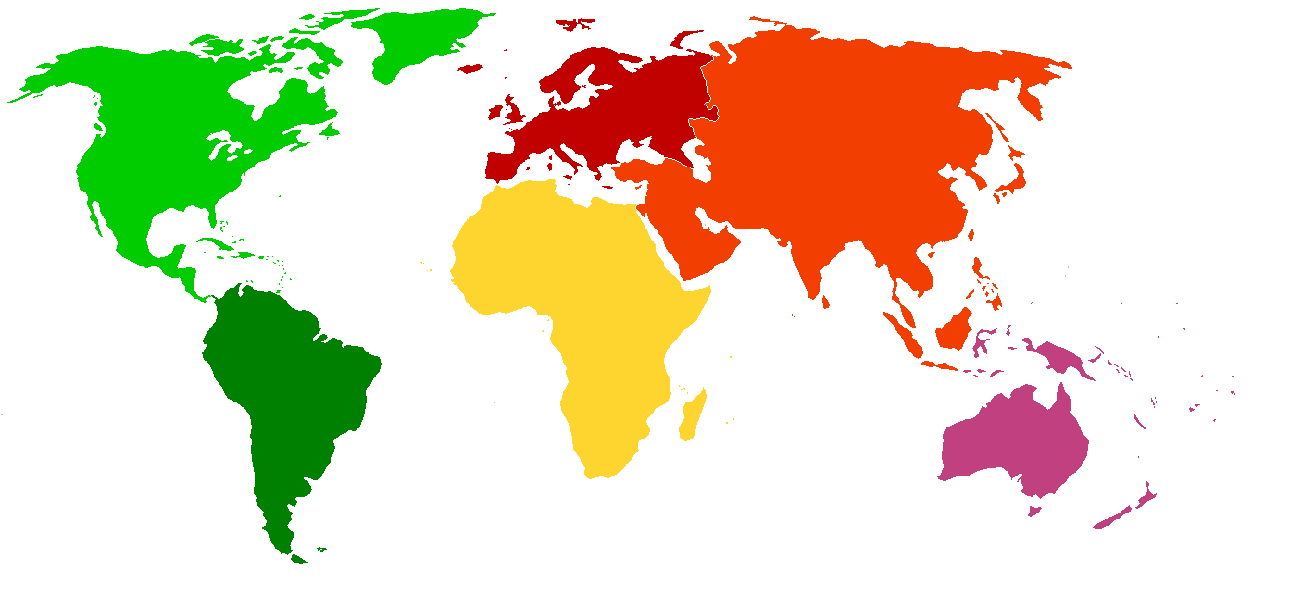
Continents and Oceans
Prime
Meridian
Arctic
Ocean
D
2
Europe
North
America
5
4
Asia
Atlantic
Ocean
Pacific
Ocean
C
A
Africa
6
Pacific
Ocean
C
Indian
Ocean
Equator
South
America
B
1
Australia
3
7
Antarctica

Slide 17
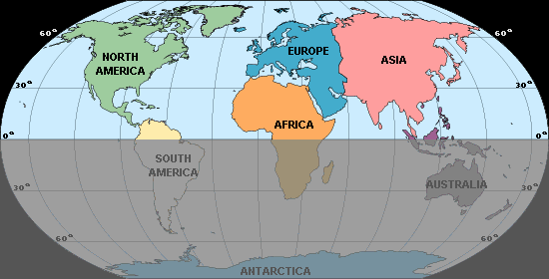
HEMISPHERES
What hemisphere is showing?
Northern Hemisphere

Slide 18
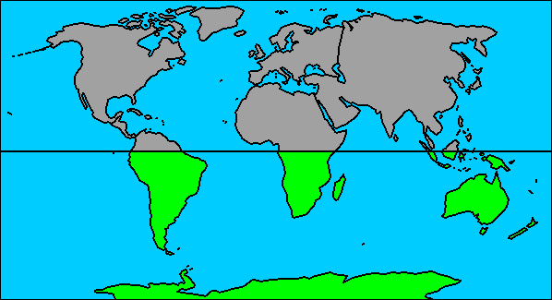
HEMISPHERES
What hemisphere is showing?
Southern Hemisphere

Slide 19
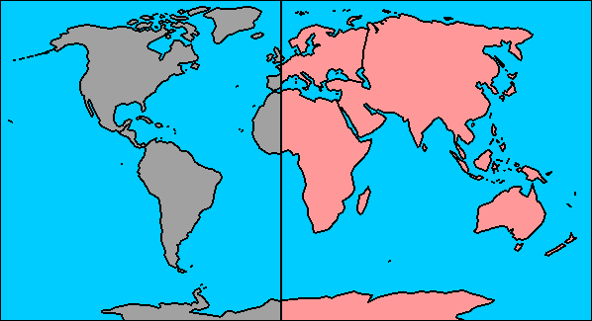
HEMISPHERES
What hemisphere is showing?
Eastern Hemisphere

Slide 20
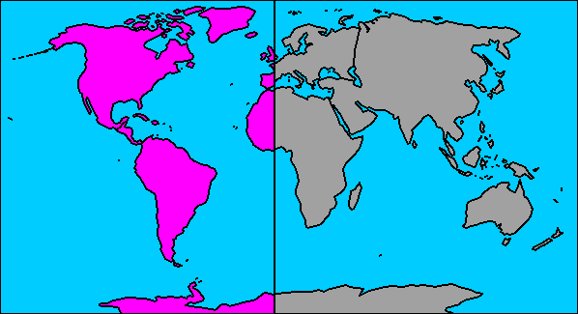
HEMISPHERES
What hemisphere is showing?
Western Hemisphere

Slide 21
Cartography Film
Link 13:00

