Slide 1
Civil Rights Movement
Reconstruction through
Montgomery Bus Boycott

Slide 2
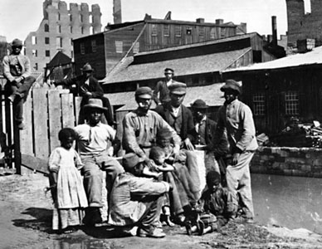
Reconstruction and the New South
The Problems of Peacemaking
Competing Notions of Freedom
Black Desire for Independence
Notes:
What were some of the ways Blacks believed freedom should be secured?
Government take land from whites and give to blacks, legal equality, virtually all former slaves desired independence from white control.
What did freedom mean to white southerners?
Control own destinies without interference from the north or the federal government. Fighting to preserve local and regional autonomy and white supremancy.

Slide 3
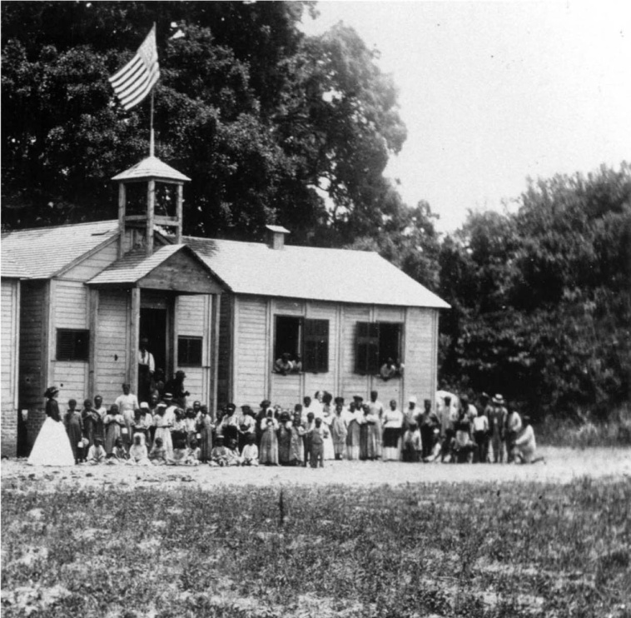
Reconstruction and the New South
The Problems of Peacemaking
Competing Notions of Freedom
Black Desire for Independence
The Freedmen’s Bureau
A Freedman’s Bureau School
Notes:
Federal troops remained in the south to preserve order and protect the new free blacks.
March 1865, congress established the Freedmen’s Bureau.
It distributed food to millions of former slaves.
Established schools
Made modest effort to settle blacks on land of their own
Authority to operate for one year so not a permanent solution, besides it was too small to effectively deal with the problems.

Slide 4
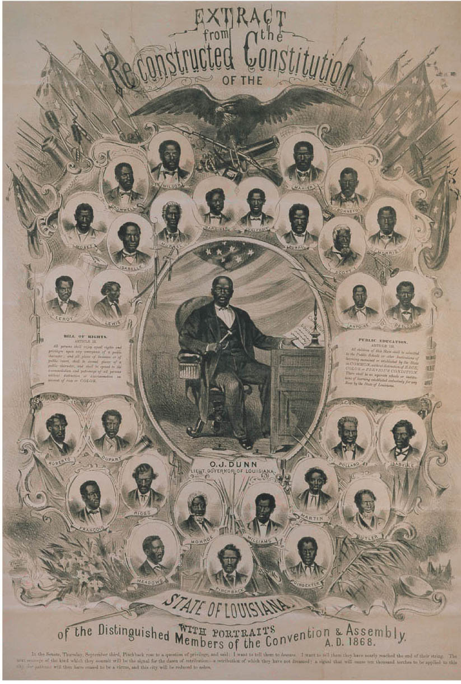
Reconstruction and the New South
The South in Reconstruction
The Reconstruction Governments
Freedmen
The Louisiana Constitutional Convention, 1868
Notes:
Blacks served many roles in the reconstruction of the south and were by far the most numerous of the southern Republicans.
They held public office of all kinds to include 20 in the House and 2 in the Senate during the period 1869 to 1901.
The success of the Reconstruction governments in the south is mixed. Critics charged they were corrupt and spent money on unneeded things. While true this was the condition of the governments before the war.

Slide 5
Reconstruction and the New South
The South in Reconstruction
Education
Establishment of Black Schools
Notes:
A large network of schools were established after the war to educate the former slaves.
By 1876 more than half the white kids and about 40% of the blacks were attending schools – even if most were segregated.
Black colleges and universities got their start during this time period. Hampton Institute and Tuskegee Institute.

Slide 6
Reconstruction and the New South
The South in Reconstruction
Landownership and Tenancy
Land Reform Thwarted
40 acres and a mule...?
Notes:
The Radicals wanted to provide land to the Freedmen (40 acres and a mule for each) but this plan failed as most of the land taken from whites was returned.
Black ownership of land did rise from nothing to around 20% while white ownership of land declined from 80% to 67% due to money issues.

Slide 7
Reconstruction and the New South
The South in Reconstruction
Landownership and Tenancy
Land Reform Thwarted
Rapid Growth of Sharecropping
Notes:
Most of the poor blacks and poor whites did some sort of sharecropping – pay landlords a fixed rent or a share of their crop. Most poor were in such debt they could never work enough to purchase the land but they did have a sense of being free to work their own land.
The landlords won as they did not have to purchase slaves and be responsible for their upkeep.

Slide 8
Reconstruction and the New South
The Abandonment of Reconstruction
Waning Northern Commitment
Flagging Interest in Civil Rights
Notes:
Support for civil rights started to decline with the passage of the 15th amendment. People felt that with the vote blacks would be able to take care of themselves in the south.
Southern states were electing white democrats to the office and in 1874 the Democrats controlled the House for the first time since 1861.
Blacks were left to fend for themselves and found their rights violated often.

Slide 9
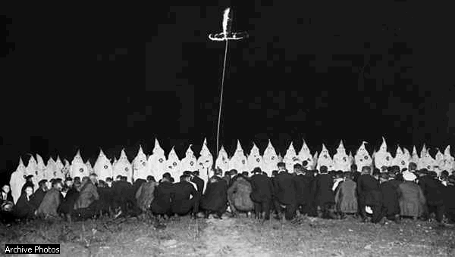
Reconstruction and the New South
The Abandonment of Reconstruction
The Southern States “Redeemed”
Ku Klux Klan
Notes:
Reconstruction officially ends in 1877 when the last of the federal troops leave the south.
The main objective of the white southerners when the troops left a state was to get back control of the state government by voting out the Republicans and voting in Democrats.
Organizations like the Klan, actually founded as a fraternal organization for Confederate veterans, use violence and intimidation to ensure elections went the way the whites wanted them to go.
Economic pressures were also used as blacks were refused work, land or credit in hopes of driving them out of certain areas.
The Enforcement Acts or Ku Klux Klan acts of 1870 and 1871 prohibited states from discriminating against voters on the basis of race and the federal government could prosecute individuals who violated voters rights.
This did reduce the violence from the Klan but they will make an unfortunate comeback in the 20th century.

Slide 10
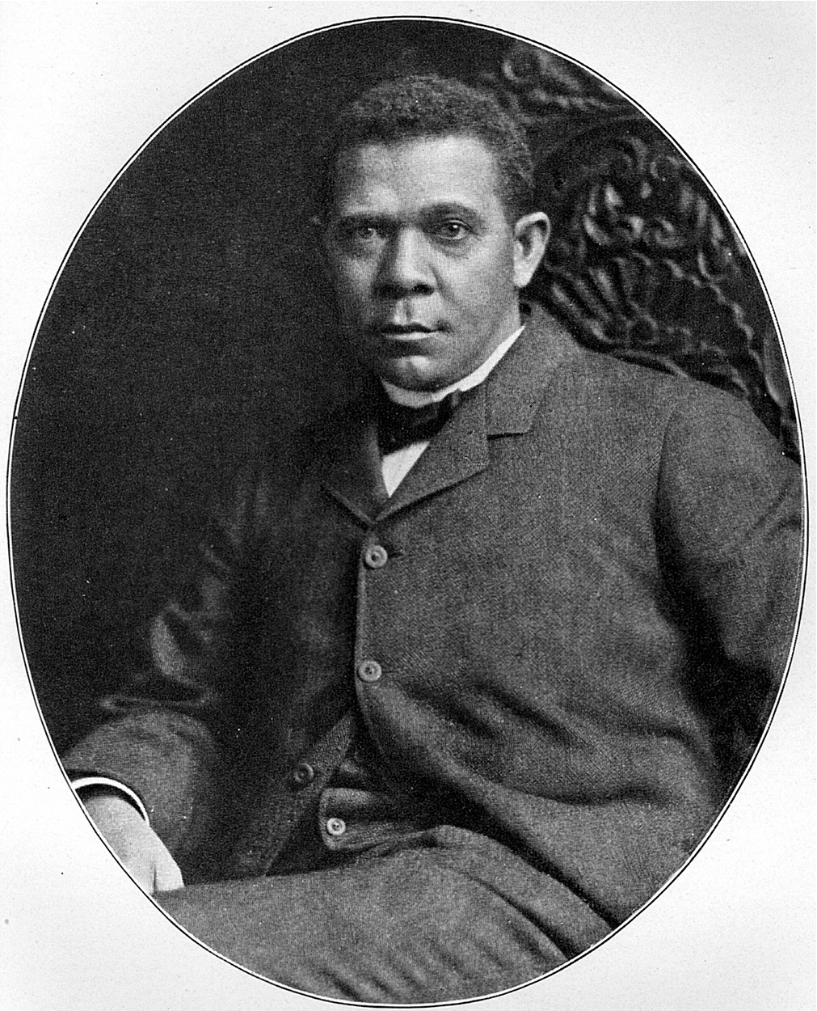
Reconstruction and the New South
The New South
African Americans and the New South
Booker T. Washington
“Educate the black man, mentally and industrially, and there will be no doubt of his prosperity.”
- Booker T. Washington
Notes:
A middle class developed in the black community made up of former slaves and their decedents.
This group believed in education as the key to success.
Booker T. Washington was a chief spokesperson for this group. He was president of Tuskegee Institute in Alabama.
What was his message?
African Americans should attend school, learn skills and establish a solid footing in agriculture and the trades. Industrial, not classical , education should be the goal.
Black should refine their speech, improve their dress, and adopt habits of thrift and personal cleanliness – on other words adopt the standards of the white middle class and thus gain the respect of the white population.

Slide 11
Reconstruction and the New South
The New South
African Americans and the New South
Booker T. Washington
Atlanta Compromise
“In all things that are purely social we can be as separate as the fingers, yet one as the hand in all things essential to mutual progress.”
- Booker T. Washington
Notes:
This was a controversial speech given in Atlanta in 1895 basically promising the white population that blacks would keep to themselves and not upset the political realities but would seek education and improve their lives within their own community.
Whites applauded the speech but the black community received it with mixed feelings.

Slide 12
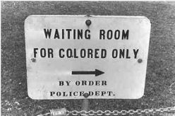
Reconstruction and the New South
The New South
The Birth of Jim Crow
Plessy v. Ferguson
“In my opinion, the judgment this day rendered will, in time, prove to be quite as pernicious as the decision made by this tribunal in the Dred Scott case…”
- Justice John Harlan
Notes:
The idea of racial equality never really gained acceptance within the south. When federal troops left in 1877 and the supreme court ruled that individuals could discriminate against people just not states, weakening the 14th amendment, the props of racial equality in the south were removed.
Plessy v Ferguson
The court ruled that separate but equal facilities could be the standard.
Cumming v County Board of Education
Communities could establish schools for whites only without making accommodations for black schools.

Slide 13
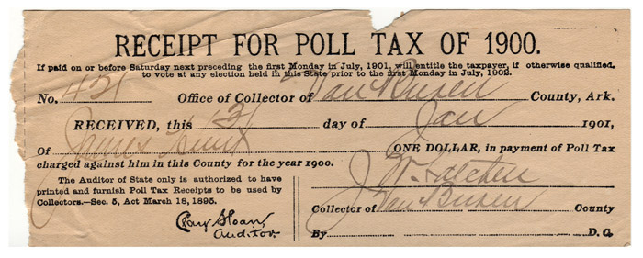
Reconstruction and the New South
The New South
The Birth of Jim Crow
Plessy v. Ferguson
Skirting the 15th Amendment
Notes:
What were some of the ways whites prevented blacks from voting?
Poll tax or some form of property qualification.
Literacy or understanding test.
These affected poor whites as well as blacks – by the 1890s black vote down 62%, white vote down 26%.

Slide 14
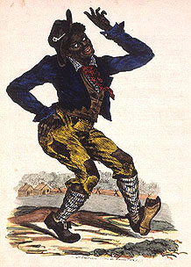
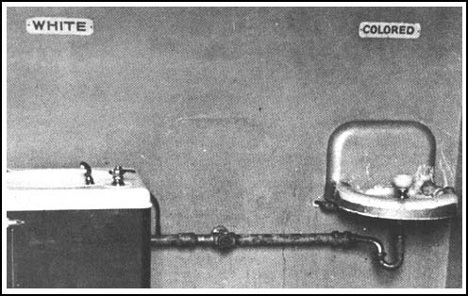
Reconstruction and the New South
The New South
The Birth of Jim Crow
Plessy v. Ferguson
Skirting 15th Amendment
Jim Crow Laws
Notes:
Jim Crow laws were used to separate the races in the south. By the beginning of the 20th century virtually all public services in the south were separate.
Violence was used to “control” the blacks in the south. By the 1890s this violence had dramatically increased.
187 lynchings on average per year with more than 80% of them in the south and the vast majority of the victims being black.
The groups who did the lynching saw themselves as enforcing law.

Slide 15
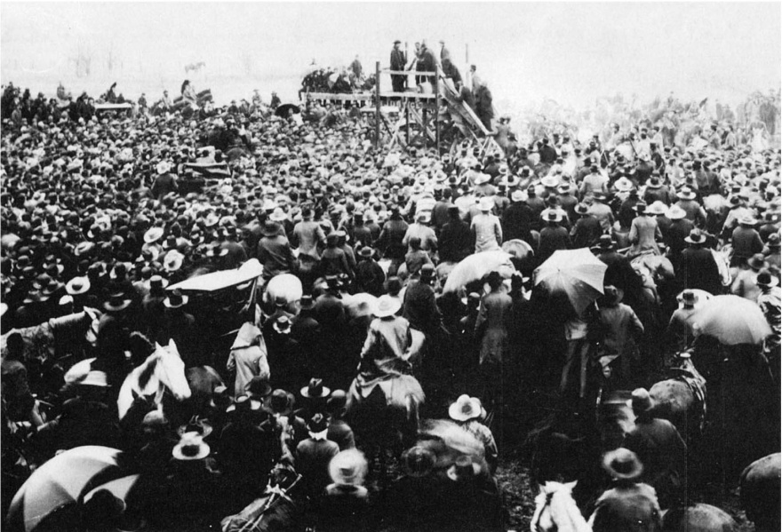
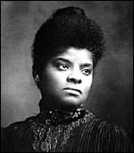
Reconstruction and the New South
The New South
The Birth of Jim Crow
Plessy v. Ferguson
Skirting 15th Amendment
Jim Crow Laws
Ida B. Wells
A Lynch Mob, 1893
Notes:
She attempted to get the federal government to create anti-lynching laws to punish those responsible but the efforts were turned back.
Poor whites and rich whites united to keep race the overwhelming priority in the south and economic prosperity suffered as a result. It is often thought that this focus on race kept the south from reaching its full potential as an economic power in American like it had been at the founding of the country.

Slide 16
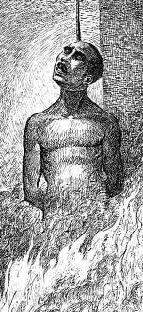
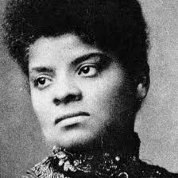
IV. Violence Against Blacks
Lynching
1882-1892: 1,400 lynchings, mostly in South
B. Reason
Not following de facto rules
White feels disrespected → black death
C. Ida B. Wells fights
Newspaper editor in Memphis
3 friends lynched
Crusades in 1890s/1900s to stop it

Slide 17
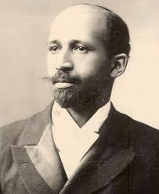
III. W.E.B. Du Bois
Northern born – never a slave
Booker T. a traitor to black race
Rejects gradualism
Demands immediate full equality
“Persistent manly agitation…”: militant
Talented 10th
Top 10% of blacks to get higher education and “lead the masses”
Niagara Movement (1905)
Develops into NAACP (1909)

Slide 18
Progressive Reform (1903)
Sources of Progressive Reform (1903)
African Americans and Reform
W.E.B. Du Bois
“Is it possible and probable that nine millions of men can make effective progress in economic lines if they are deprived of political rights, made a servile caste, and allowed only the most meager chance for developing their exceptional men?”
W. E. B. Du Bois
Notes:
The race question was one of serious debate among progressives except in the south were progressives felt segregation had met all the goals.
African Americans themselves started to embrace change in the new century. Many would reject the ideas of Booker T. Washington and start to look for long-range social change.
William Edward Burghardt Du Bois was a leading proponent of the new approach to race relations where blacks should strive for full university educations, they should aspire to the professions and above all they should fight for civil rights.

Slide 19
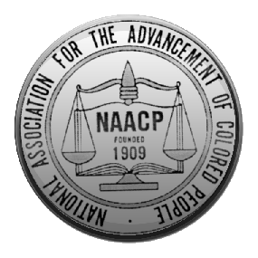
Progressive Reform (1903)
Sources of Progressive Reform
African Americans and Reform
W.E.B. Du Bois
NAACP Founded (1905)
Notes:
In 1905, De Bois and a group of his supporters met on the Canadian side of Niagara Falls (no place on the American side would have them) and formed the Niagara Movement.
Four years later this movement would join white progressives to create the National Association for the Advancement of Colored People. This group looked to create equal rights using lawsuits in courts.

Slide 20
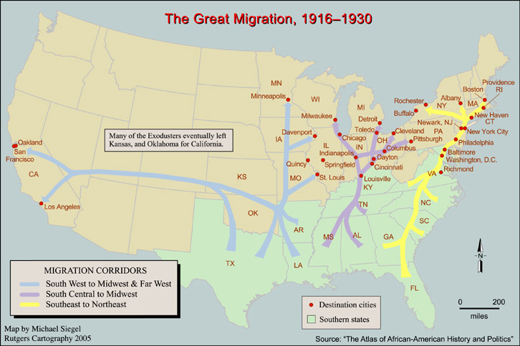
I. Great Migration
A. During/after World War I
B. South to North for better jobs/pay
C. Example: Chicago (1910-’30): 44k -> 234k.

Slide 21
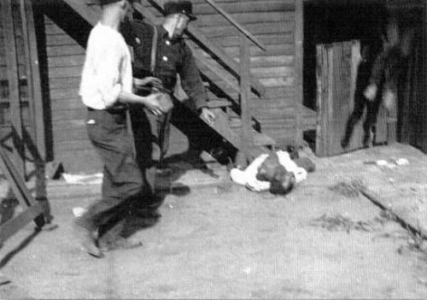
II. GM Causes Racial Unrest
A. Summer of 1919
1. Over 20 race riots
2. Chicago’s lasted 2 weeks
a. toll: 38 dead, 500 injured

Slide 22
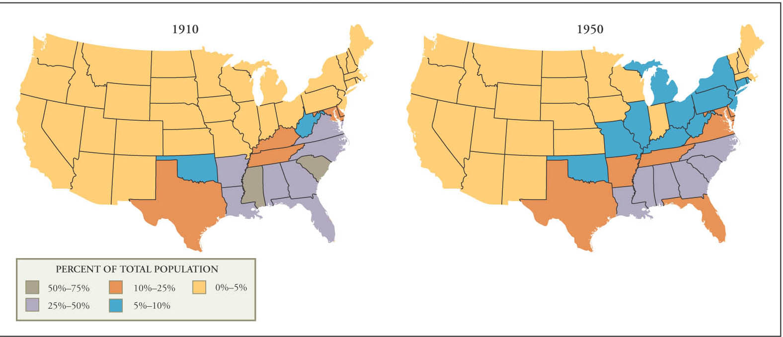
World War I Era
The Demands of African Americans
“Great Migration”
African-American Migration, 1910-1950
Notes:
When black soldiers came back from the war they participated in parades with the whites down the main streets of most major American cities. Then they marched down the main streets of black neighborhoods led by jazz bands. African-Americans believed they would never again be treated as less than equals because of their war service.
In reality the whites did not change their attitudes at all and blacks started moving from the rural south to the industrial north in what would be called the Great Migration. Nearly half a million moved during the war years and up until the 1950s. This changed the face of many northern cities as large neighborhoods of African Americans emerged.

Slide 23
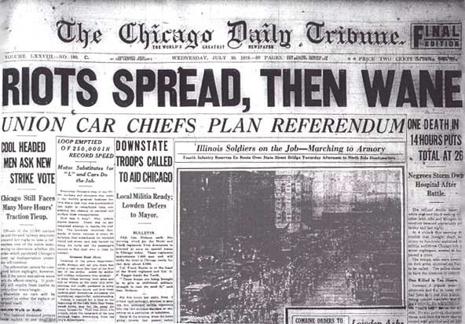
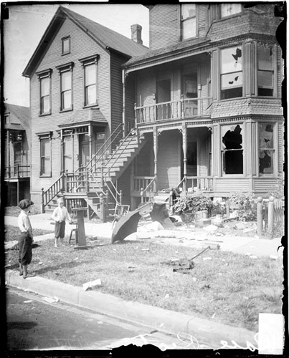
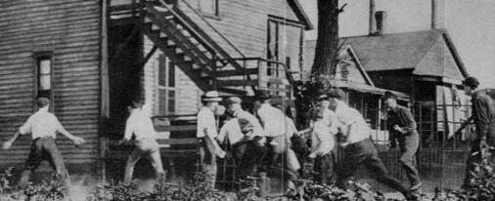
World War I Era
The Demands of African Americans
“Great Migration”
Chicago Race Riot
Notes:
By 1919 race relations took a turn for the worse. In the south lynching increased, in the north many blacks found themselves out of a job as they were replaced by white workers. Whites felt blacks were hurting them economically because they demanded lower wages.
In the summer of 1919 in chicago a black boy, Eugene Williams drifted to close to a whites only beach while swimming. The whites stoned him unconscious and he drowned. The police refused to arrest the whites who threw the stones, but instead arrested a black man who complained about it. Angry blacks stormed into white neighborhoods to retaliate and whites fought back going into black neighborhoods. After one week there were 38 dead, 15 white and 23 black, 537 injured and over 1,000 homeless.
While this was the worst of the riots it was not the only one as 120 people died in 1919 due to riots in various cities.

Slide 24
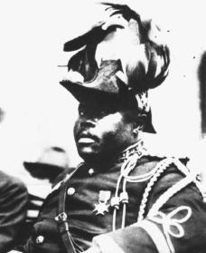
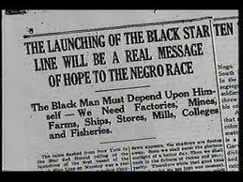
III. Marcus Garvey
Black Nationalism: pride in being black
UNIA (United Negro Improvement Assoc.)
Reject assimilation
Create black-only society
Back to Africa Movement
Black Star Line (ships)
Create powerful black nation in Africa
Didn’t happen
Legacy:

Slide 25
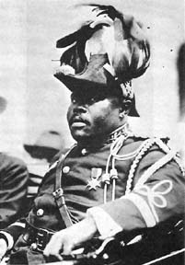
World War I Era
The Demands of African Americans
“Great Migration”
Chicago Race Riot
United Negro Improvement Association
Notes:
The NAACP told blacks to not just demand government protection but to also defend themselves.
A black Jamaican named Marcus Garvey, created the United Negro Improvement Association, and charged blacks to reject assimilation into white society and develop pride in their own race and culture.
His organization launched a chain of black owned grocery stores and several other businesses.
Eventually Garvey urged his supporters to leave America and move back to Africa to create a new society of their own. His movement grew during the early 20’s but in 1923 Garvey was indicted on charges of business fraud (may have been real, may not have been)
Garvey was deported to Jamaica in 1925 but his ideas stayed with the black community long after he was gone.

Slide 26
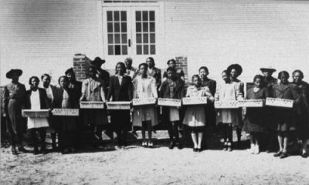
New Deal Era (1930s)
Limits and Legacies of the New Deal
African Americans and the New Deal
The “Black Cabinet”
Notes:
Roosevelt did appoint several blacks to second-level positions in his administration, Eleanor Roosevelt, Interior secretary Harold Ickes, and WPA director Harry Hopkins all made efforts to ensure that New deal relief programs did not exclude blacks. By 1935, an estimated 30% of blacks were getting some form of assistance from the government. (the picture shows blacks with chicks given to them by the government to help with dietary needs)
This resulted in a shift in voting patterns. In 1932 most blacks voted Republican as they had since Reconstruction but by 1936, 90% voted Democratic.
Roosevelt did not support legislation to make lynching a federal crime or ban the poll tax.

Slide 27
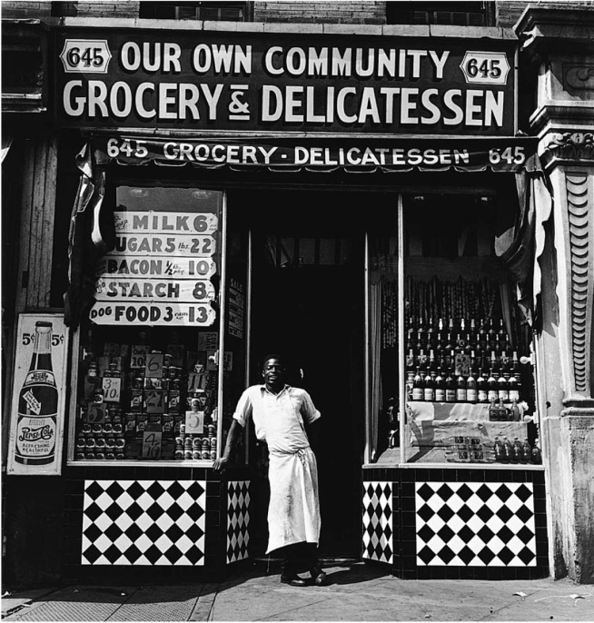
New Deal Era (1930s)
Limits and Legacies of the New Deal
African Americans and the New Deal
The “Black Cabinet”
Discrimination Reinforced
Harlem Grocery Store, 1940
Notes:
The New Deal did reinforced discrimination. The Civilian Conservation Corp segregated by race. The NRA tolerated paying blacks less than whites for the same work. The WPA gave blacks and Hispanics the least-skilled and lowest paying jobs and when money dried up blacks and women were the first dismissed.

Slide 28
World War II Era
Double V Campaign
Home and at war

Slide 29
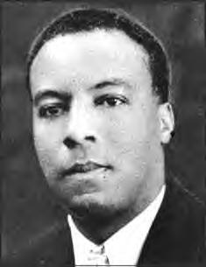
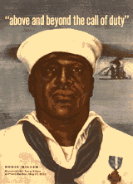
World War II Era
African Americans and the War
A. Philip Randolph
Notes:
A Philip Randolph, president of the Brotherhood of Sleeping Car Porters, demanded defense contracts be given to only those companies with an integrated work force. He planned a march on DC but Roosevelt persuaded him to cancel the march in return for the Fair Employment Practices Commission which would investigate discrimination cases.

Slide 30
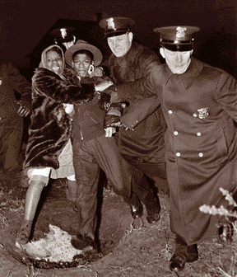
World War II Era
African Americans and the War
A. Philip Randolph
Wartime Race Riots
Notes:
The need for labor led to the migration of many blacks to industrial cities. While this bettered the economics of the community it also created tensions and in some cases violence. In Detroit in 1943, race riots killed 34, 25 of which were black.
The Congress of Racial Equality (CORE) fought to integrate theaters, restaurants and the like. They found some success in the North.
The military was segregated during this time and a move to change this met stiff resistance. The Marine Corp and Army Air Force excluded blacks completely until late in the war.
Talk about Tuskegee Airmen.

Slide 31
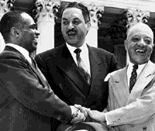
The Rise of Civil Rights Movement
The Brown Decision and “Massive Resistance”
Brown v. Board of Education
“We conclude that in the field of public education the doctrine of ‘separate but equal’ has no place.”
George E.C. Hayes, Thurgood Marshall, and James Nabrit congratulating each other after the Brown decision, 1954 (Library of Congress)
Notes:
In 1954, the Supreme Court announced a decision on the Brown v Board of Education of Topeka. The court reversed its earlier decision of 1896 in Plessy v Ferguson and called for the integration of American public schools.
Chief Justice Earl Warren called for the desegregation to be down with all deliberate speed but set no timetable.
Southern opposition was strong and movement to integrate slow.

Slide 32
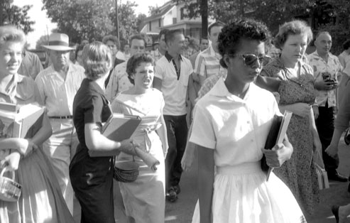
The Rise of Civil Rights Movement
The Brown Decision and “Massive Resistance”
Brown v. Board of Education
Little Rock’s Central High School
Notes:
In Little Rock Arkansas, whites blocked black students from attending Central High. The Governor refused to intervene, so President Eisenhower was forced to send federal troops to escort the 9 students to school and keep the peace.

Slide 33
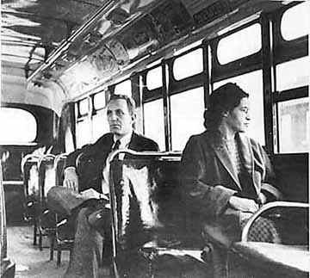
The Rise of Civil Rights Movement
The Expanding Movement
Rosa Parks
“All I was doing was trying to get home from work.”
- Rosa Parks
Notes:
In 1955, Rosa Parks refused to move to the back of a public bus in Montgomery Alabama. She was arrested and this inspired a boycott of the buses in Montgomery. The boycott was economically effective but if the Supreme Court had not stepped in and ruled to desegregate public transportation things might have continued as they had.

Slide 34
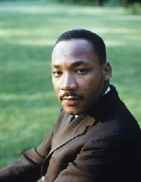
The Rise of Civil Rights Movement
The Expanding Movement
Rosa Parks
Martin Luther King, Jr.
“We have waited for more than three hundred and forty years for our constitutional and God-given rights.”
Martin Luther King, Jr.
Notes:
The Montgomery bus boycott launched the career of a local Baptist pastor, Martin Luther King, Jr.
King advocated nonviolence as a way to break injustice. He took the high moral ground and stuck to it in the face of overwhelming odds. For 13 years he lead the Southern Christian Leadership Conference (SCLC) and was one of the most admired racial leaders in the country.

Slide 35
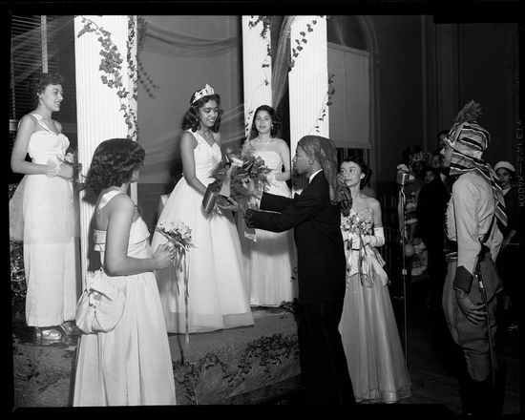
The Rise of Civil Rights Movement
Causes of the Civil Rights Movement
Growing Urban Black Middle Class
Political Mobilization of Northern Blacks
Notes:
A group within the African American community lead the fight against injustice and that was the Black middle class. These men and women of education organized and worked to remove the obstacles of oppression.
TV also motivated Blacks towards the civil rights movement – the constant reminders of the white society in which they lived, a world they were excluded from, inspired some to protest.
The Cold War exposed how blacks were being treated when America was trying to show how it was right for the world.
Blacks voted mostly Democratic during this time.

