Slide 1
World War II Begins
FL. State Standard 6.1

Slide 2
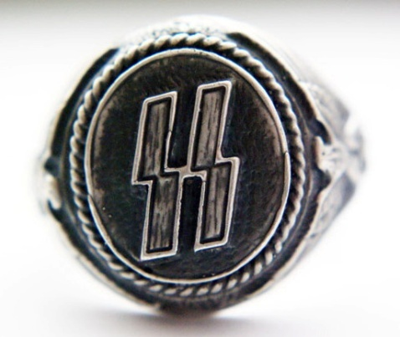
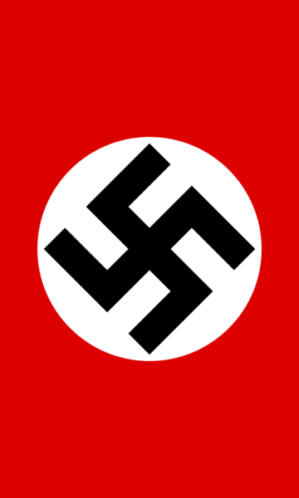
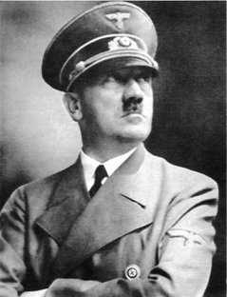
I. Causes
A. Treaty of Versailles
1. Harsh
2. Reparations/War guilt
B. Rise of Hitler
1. Promise of pride
2. “Not your fault”
* Jews
Notes:
Treaty of Versailles from WW1 was much too harsh on Germany. Remember, they were forced to pay $33 billion in reparations and to sign the war guilt clause, in which they had to accept full and sole responsibility for starting WW1. This, especially, was a psychological hit and would leave the Germans looking for a way to prove their worth to their enemies in the future.
Hitler came along in the 1930s and told them exactly what they wanted to hear: WW1 was not Germany’s fault and that the people should be proud of their German heritage, not ashamed. Coupled with the Great Depression, Hitler’s ideas sold well to German people. Hitler used Jews as the scapegoat for all Germany’s problems – it was their fault as well.

Slide 3
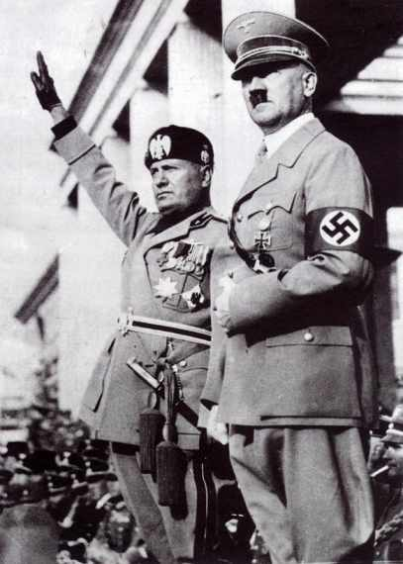
C. Rise of Fascism
1. authoritarian political ideology
2. Individuals not important.
3. national unity, usually based on, but not limited to, ethnic, cultural, racial, and religious attributes.
Notes:
Fascism arose in all three of the major Axis Power countries: Germany, Italy and Japan. Very much an idea of “Nationalism”

Slide 4
II. Appeasing Hitler
A. The Anschluss
1. Hitler’s unifying of German-speaking
people
2. Starts with Rhineland (’36) & Austria (’38)
B. The Munich Conference &
policy of appeasement
1. Appeasement: give in to avoid conflict
a. Hitler wants/gets
Czechoslavakia
b. France/Brits think Hitler satisfied
Notes:
Appeasement: means to give in to avoid conflict. Hitler started to violate treaty of versailles in 1936 when he invaded and took over neighboring areas. He said he those areas wanted to be part of Germany, so he should be able to do it.
Allies allowed it because they were also in the Depression and had no money or heart to wage war. So as long as Hitler PROMISED he wouldn’t take any more land, then they would allow him to keep what he’d already taken. Idiots.

Slide 5
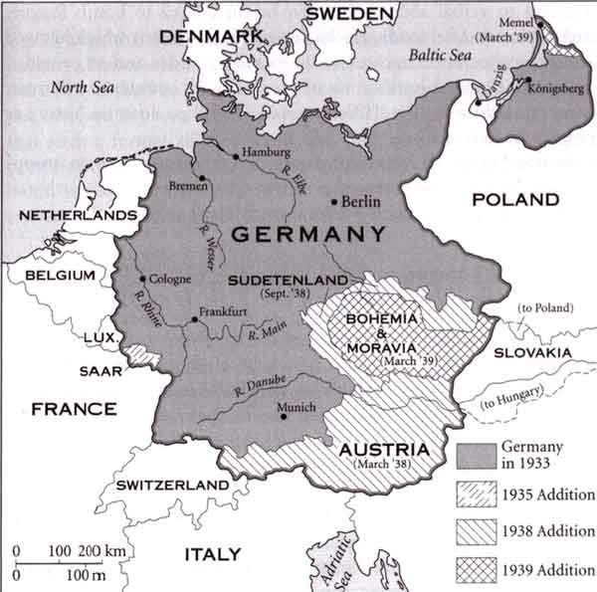
GERMAN AGGRESSION

Slide 6
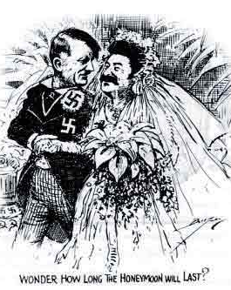
III. Nazi-Soviet Pact
Hitler wants Poland
B. Makes Russia safe
C. Advantage for Germany:
only fight on 1 front if war
starts w/GB & France
D. The 2 countries secretly
agree to split Poland
Notes:
Germany and Soviet Union (formerly known as Russia) agreed to a non-aggression pact. In it, they agreed to conquer and split Poland (which had been formed after WW1 from areas that had previously been German and Russian). Hitler wanted it b/c he knew it would start war with Britain and France and he didn’t want to have to fight a war on two sides (East and West), which he’d have to if Russia joined in.
Soviets wanted it b/c they wanted the land and didn’t want to fight and this guaranteed their safety from Germany (yeah, right!)

Slide 7
IV. The War Begins
A. Blitzkrieg in Poland: Sept. ’39
1. Starts Sept. 1 → GB/France declare war on 3rd
2. Poland falls in 35 days
B. The Fall of France
1. Maginot Line on border
a. Invaded Belgium (go around Maginot Line)
2. Paris fell June 22, 1940
Notes:
Once Hitler invaded Poland, that was it. War was on. But Hitler’s military quickly took care of Poland and then, of course, the French fall like a house of cards. Wimps.
Dunkirk: expected to be able to get 45k out, but hitler ordered 3-day delay that allowed the 300k+ to evac

Slide 8
The U.S. From Isolation to the Brink of War
FL State Standard 6.2

Slide 9
CONCEPTS
US wanted to stay neutral – make money selling both sides/still isolationist belief we don’t have to get into other people’s problems. But still supported Britain b/c against dictatorships
Neutrality Acts
Cash and Carry
American First Committee
Lend-Lease Act
Atlantic Charter
KEY TERMS

Slide 10
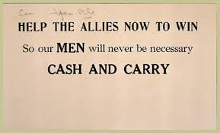
I. Aiding the Allies
A. Neutrality Act of 1939
B. Cash and Carry Plan
Notes:
The US wanted to be neutral because, like always, war costs money. But we still wanted to help Great Britain, so we came up with Cash and Carry policy.
Cash and Carry: we’d sell supplies to the Allies BUT they had to pay cash AND come pick it up with their own boats. We didn’t want to take it to them, b/c if the Germans sink our ships, then we HAVE to get into war, just like in WW1.
Destroyers for Bases: Brits needed warships, but couldn’t afford to buy any of ours with cash, so we traded them warships for access to their military bases around the world.

Slide 11
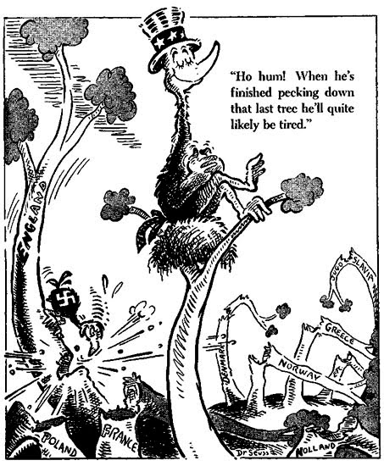
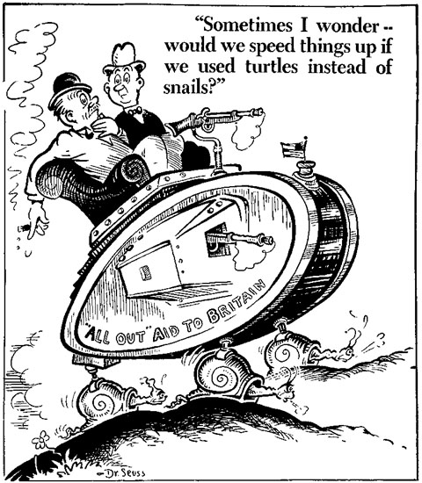
II. U.S.: Do we or don’t we enter?
A. The debate over isolation
1. Fight for Freedom vs. America First Committee
Notes:
Fight for Freedom folks: Join the war with Allies and fight for the freedom of people from Hilter’s oppression.
America First: Stay neutral. Worry about America first, not other people halfway around the world. Isolationists

Slide 13
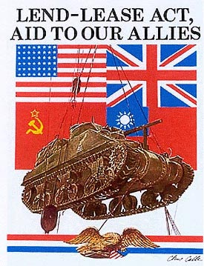
III. Edging Toward War
A. The Lend-Lease Act
1. 80% Americans approve
2. aid to countries that are “Vital to
the defense of democracy & freedom”
3. FDR: if don’t help, an “Unholy
Alliance” would conquer world
4. $50 billion in weapons, vehicles
and supplies
Notes:
Lend-Lease Act: Allies ran out of $$ to use to buy supplies, so we institute lend-lease. Allows US to supply allies through “loaning” them supplies or “leasing” them ships, tanks, etc.
FDR said aiding allies was vital to the defense of democracy and freedom and Lend-Lease Act would be available to any country fighting for those ideas. 80% of Americans approve of this in 1940.
Lend-Lease extended to Soviets when Germany invades them (see, can’t trust Hitler!)

Slide 14
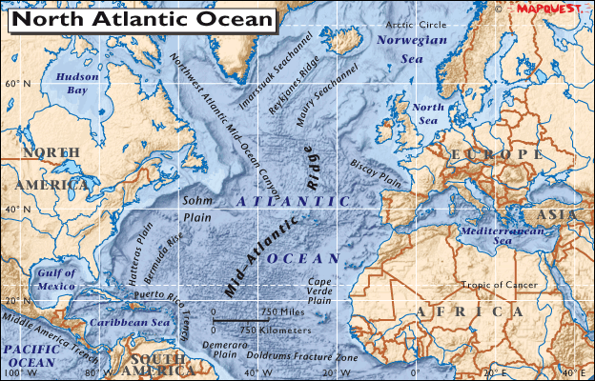
B. The Atlantic Charter
1. FDR and Churchill
2. War aims for allies: disarmament,
economic cooperation, freedom of seas
3. U-Boats “shoot on sight”
Notes:
Atlantic Charter: list of war aims put together by US and Britain. Roadmap to post-war world: disarmament, self-determination, cooperation economically, freedom of the seas and the United Nations. Very similar to Wilson’s 14 Point Plan at end of WW2

Slide 15
Check for Understanding
Answer these questions on a separate sheet of paper.
1. Why did the America First Committee want the U.S. want to remain neutral?
2. What was the major difference between the Cash and Carry Plan and the Lend-Lease Act?

Slide 16
Pearl Harbor: A Day of Infamy
FL. State Standard 6.1

Slide 17
I. Reason for Japanese Attack
A. America Embargoes Japan b/c Japs were invading China
1. Export Control Act
a. we stop selling them oil, iron, etc.
b. “strategic materials”
2. Freeze Japanese assets
JAPANESE ‘RISING SUN’ BATTLE FLAG
Notes:
Embargo: means we stop dealing with them economically.
Oil, iron, etc., are known as strategic materials because they could be used to wage war. We also freeze Japanese $$ in the US so they couldn’t use it to fight against Brits/Chinese.
Pisses off Japanese royally.

Slide 18
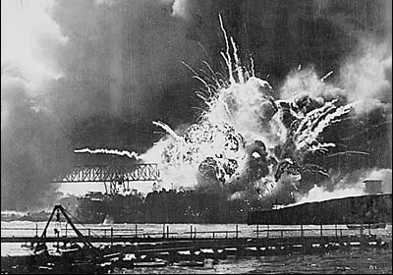
B. Japan attacks Pearl Harbor
1. Intelligence/communication failures
2. December 7, 1941
3. Japan hoped to force US peace
4. Took out 21 ships, 188 planes
5. Killed 2,400 sailors
6. 3 waves planned, only 2 executed
a.Didn’t bomb fuel oil tanks
b. Carriers were out to sea
Notes:
One Dec. 7, 1941, Japanese launch sneak attack against US Naval base at Pearl Harbor, Hawaii. This is the headquarters for the US pacific fleet.
Did major damage. But did not take out aircraft carriers, which were out to sea at the time, or the fuel oil tanks. Had they taken out fuel oil tanks, wouldn’t matter what ships/planes remained b/c they wouldn’t be going anywhere.
Jap goal: force us to seek peace before even entering war by making it impossible for us to succeed. Didn’t work.
This is the event that got us into WW2, joining the Allied Powers.

Slide 19
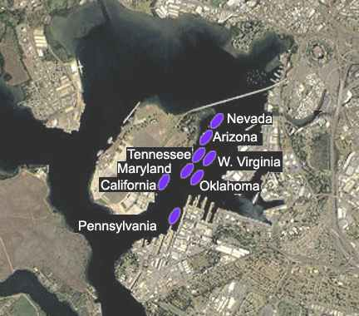
BATTLESHIP ROW, A PERFECT TARGET
TO OCEAN

Slide 20
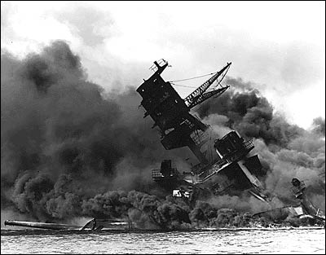
SINKING OF THE USS ARIZONA

Slide 21
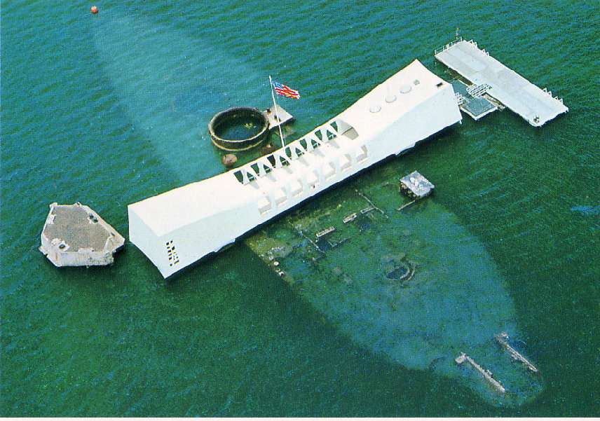
USS ARIZONA MEMORIAL

Slide 22
Promoting the War at Home
FL. State Standard 6.5

Slide 23
CONCEPTS
US homefront effort was huge. Remember, people at home just as important to winning as the soldiers fighting b/c without effort at home, soldiers have nothing to fight with. Women move to workforce again, just like WW1.
Japanese-Americans severely mistreated b/c of their heritage
War Production Board
Double V Campaign
FEPC
Japanese internment
KEY TERMS

Slide 24
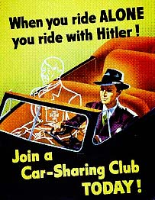
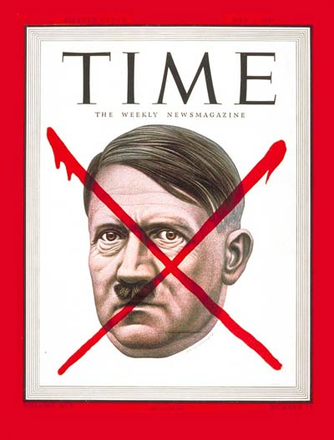
ANTI-HITLER FEELINGS IN U.S.

Slide 25
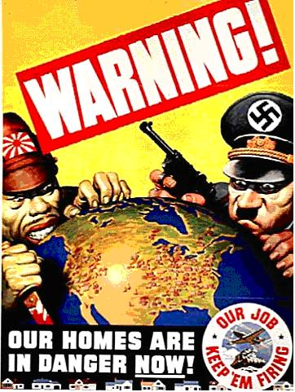
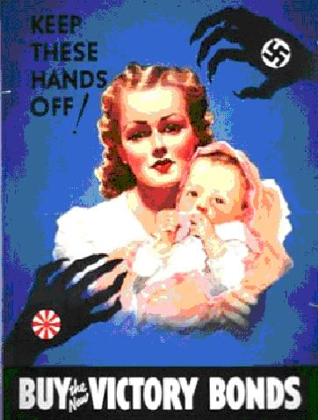
PROPAGANDA IN THE UNITED STATES

Slide 26
ROSIE THE RIVETER

Slide 27
War Production Board (WPB)
What did it do?
Notes:
WPB: controlled war production and coordinated all private companies that were prodcuing war goods. Set production goals, told factories what they were making, made sure raw materials got to where they needed to be.
Labor unions agreed to not strike during war, hoping their cooperation would gain favor later from the gov’t when disputes arose.

Slide 28
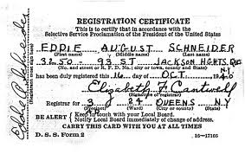
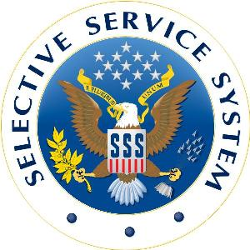
Building an Army
Selective Service and Training Act (SSA)
Eventually 15 million joined
Draft & volunteer
Notes:
Selective Service Act: known commonly as the draft. There had been two drafts prior (Civil War and WW1), but never in peace time. FDR started it in 1940, knowing that eventually we would be forced into war.

Slide 29
Check for Understanding
1. How did the War Production Board make sure we had enough goods to fight the Axis Powers?
2. What was the Selective Service Act?

Slide 30
Other Homefront Factors
Rationing
Gas, oil, food, metal
Victory Gardens and salvage
women go to work
Shipbuilding, airplane &
weapons manufacturing
Notes:
Rationing: making available only limited quantities of essential things b/c it needed to go mostly to the war front for soldiers and the military.
Victory gardens: grow your own veggies so more available to soldiers.
Women in workforce: No surprise, just like WW1, women go to work to take up slack left by men leaving for war.

Slide 31
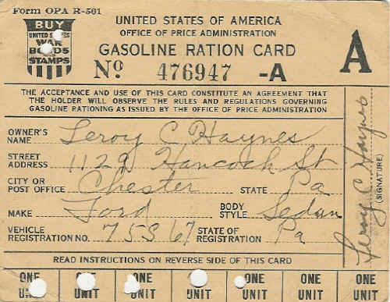
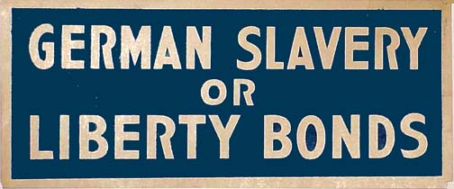
Life in the US during WWII

Slide 32
Double V and FEPC
Double V(ictory): beat racism home and beat Hitler abroad
Didn’t work. No integration of services
Black men allowed to fight (Tuskegee Airmen!)
FEPC (Fair Employment Practices Act)
No discrimination based on race for GOV’T jobs.
Notes:
African American goals.
FEPC: got gov’t to agree to outlaw racial discrimination for GOVERNMENT jobs ONLY.

Slide 33
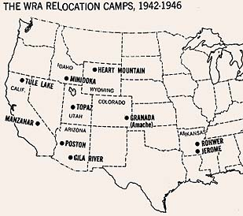
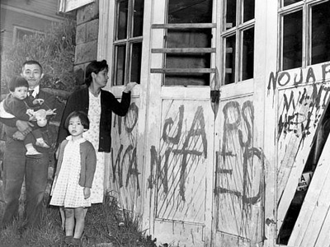
Japanese-American Internment
“Danger to America”
10 camps
Calif
Utah
Wyoming
Arkansas
120,000
Possessions sold
Notes:
In spring of 1942, Gov’t authorizes the “relocation” of Japanese Americans from the west coast. Argued they might be loyal to the Japanese and be acting as spies.
Issei: born in japan, immigrated here.
Nisei: born American citizens, but still of japanese heritage.
120,000 jap-americans sent to 10 camps for duration of war.
Kurematsu v. United States: Supreme Court case brought against gov’t arguing relocation of american citizens against the Constitution. Supreme Court upholds relocation, saying extraordinary measures can be taken during times of war to secure the safety of America.

Slide 34
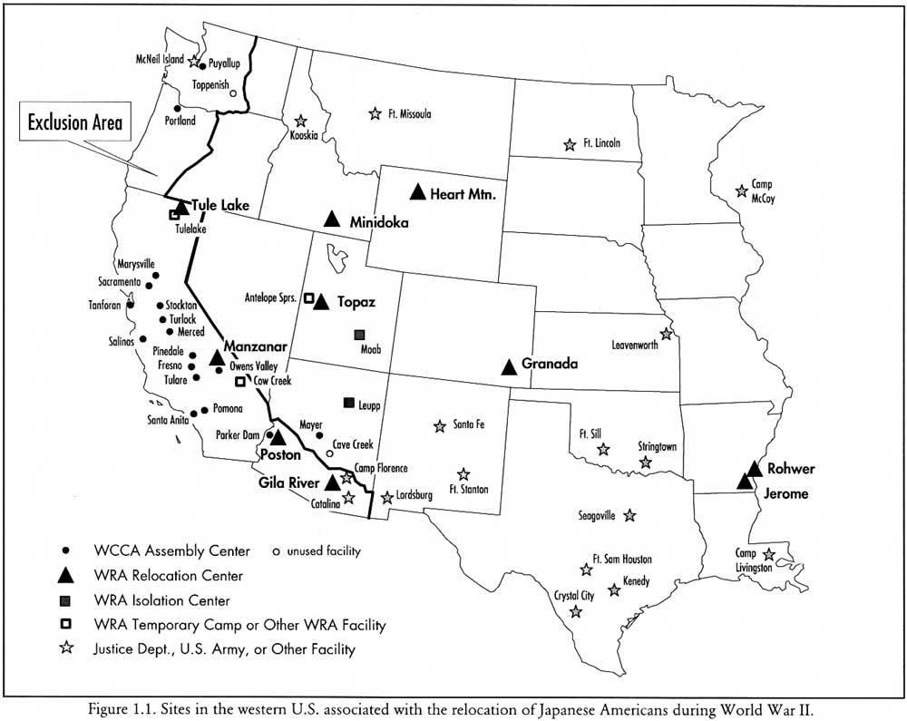

Slide 35
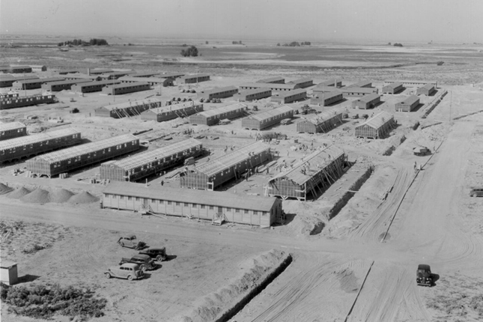

Slide 36
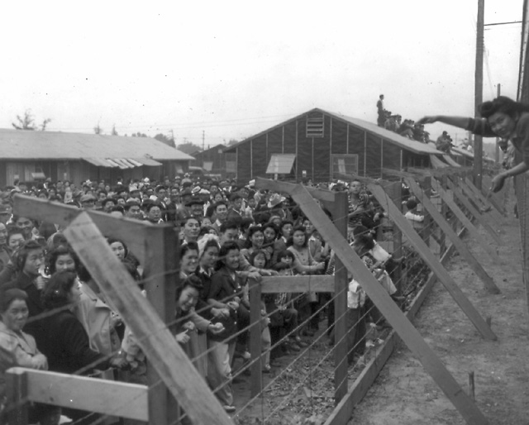

Slide 37
Check for Understanding
3. What were the 2 goals of the Double V campaign?
4. Why were Japanese-Americans interned (put into camps) during WW2?

Slide 38
Turning Point Battles

Slide 39
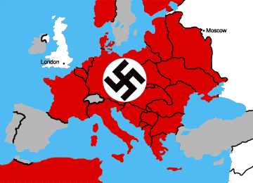
Europe in 1942

Slide 40
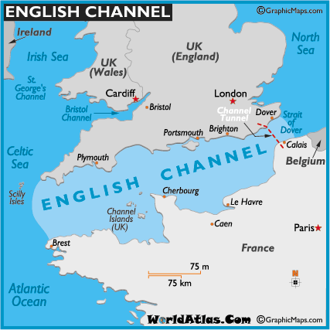
Notes:
Map shows Great Britain (top) and France (bottom), which is where the Allies would go for the D-Day (Normandy) invasion. Normandy is the region of France where the D-Day invasion landed. (went from GB to France across English Channel)

Slide 41
I. D-Day (Europe)
JUNE 6, 1944
A. 4,000 Allied ships carried the invasion force of 156,000
1) landed on beaches in the Normandy region of
France
2) Over 2,500 Allied troops died on D-Day and
another 7,500 were wounded.
B. Opened up western front, took pressure off USSR and led to Germany’s retreat & eventual defeat

Slide 42
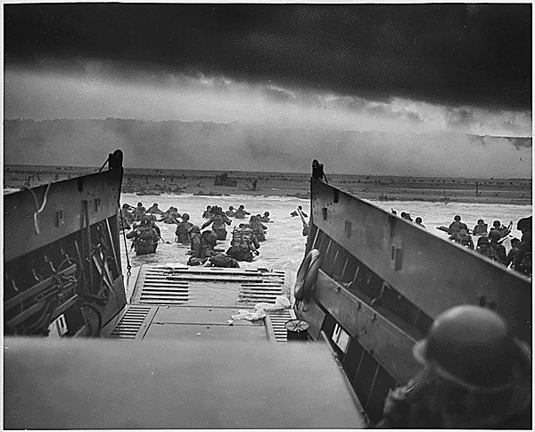
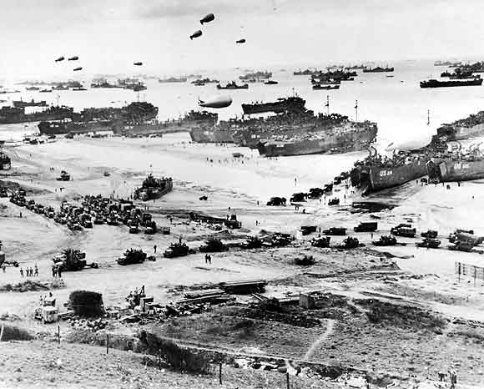
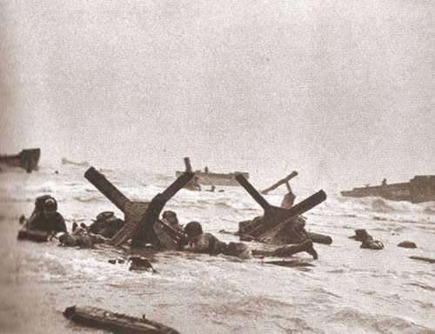
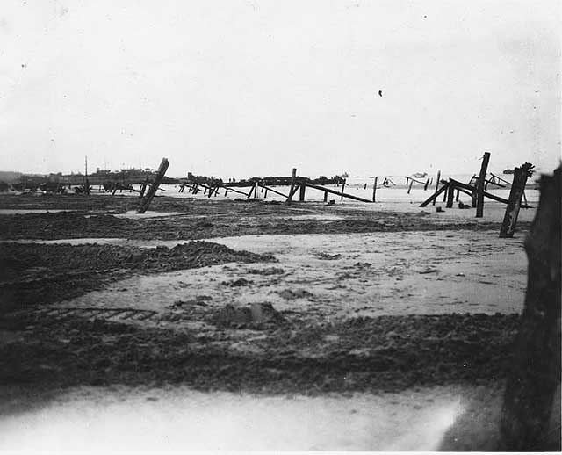
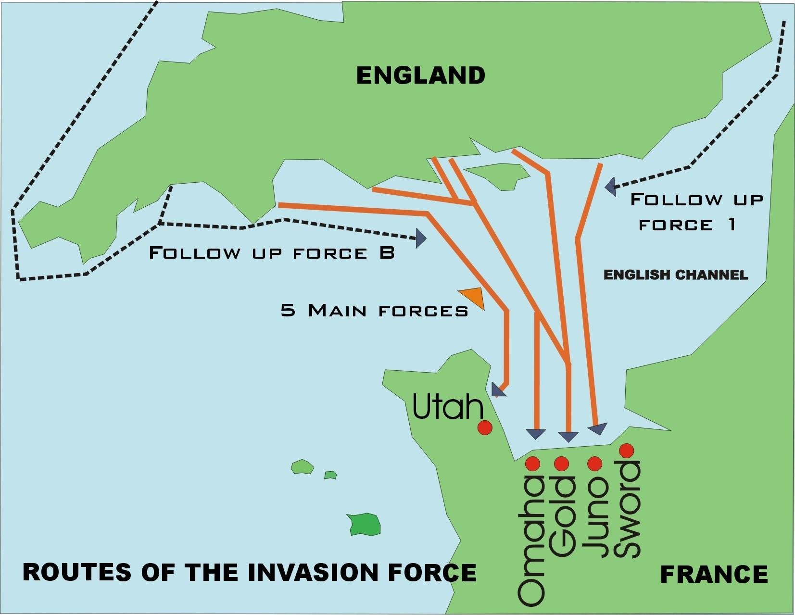
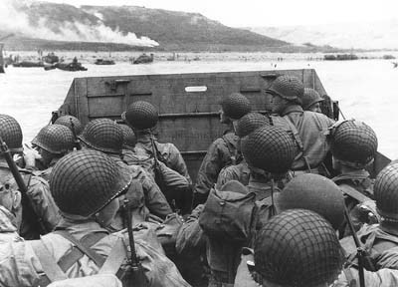
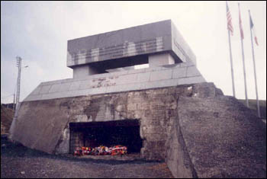
D-DAY
Notes:
Look at this full screen to see more pix, maps of D-Day

Slide 43
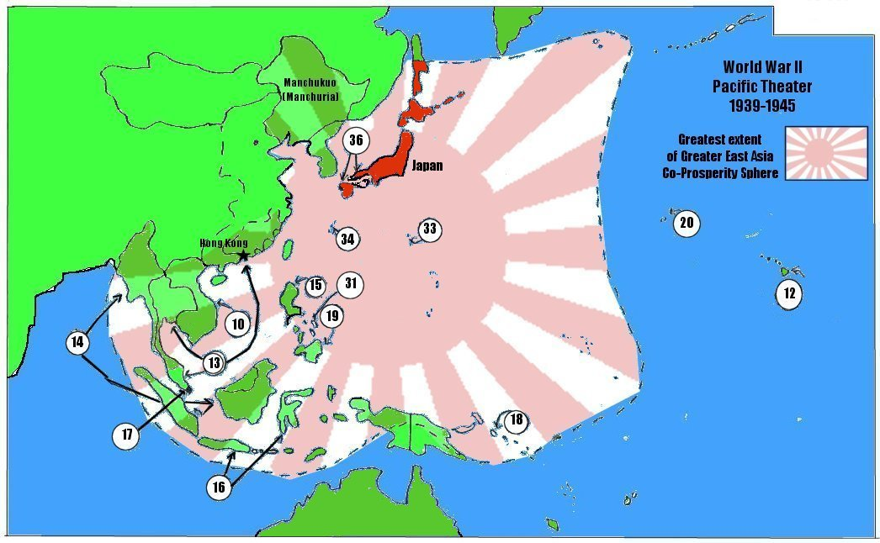
Japanese Strategy in Pacific
Notes:
Initially going south until doolittle raid. Feared bombs could kill emperor, so went with yamamoto’s plan to capture midway and draw rest of US navy into battle where they could be destroyed.

Slide 44
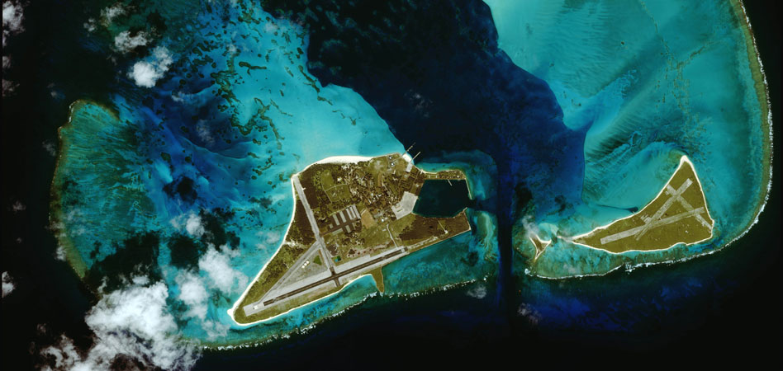
II. Battle of Midway (Pacific)
A. June 4, 1942
1. Island was only US stronghold
2. Japanese lost 4 largest carriers
a. Heart of their fleet
3. Japs play defense for next 3 years
Notes:
Turning Point battle for the Pacific. In this battle, the US sank 4 of the 9 aircraft carriers in the Japanese navy. This marked the end of Japanese expanding control in the Pacific. From this point forward, US would be pushing Japanese back toward their “home islands”.

Slide 45
Check for Understanding
Why was D-Day the turning point in Europe?
Why was Midway the turning point in Pacific?

Slide 46
World War II in Europe

Slide 47
CONCEPTS
Allies needed foothold in mainland “Fortress Europe”, so designed the Normandy invasion (D-Day). Goal, which was decided at Tehran Conference, was to force Germany to fight a 2-front war (split army against allies both East (Russia) and west (GB/USA).
Normandy invasion (D-Day)
Tehran Conference
KEY TERMS

Slide 48
Europe in 1942

Slide 49
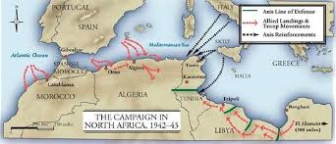
I. Turning Back the German Army
A. Allies agree to beat Hitler, then go after Japan
B. Start in North Africa (Nov. ‘42): Why?
1. Get experience, use few troops
Notes:
Wanted to start in N. Africa because US troops had no experience. N. Africa lightly defended. Nice little scrimmage before the challenge of invading “Fortress Europe”

Slide 50
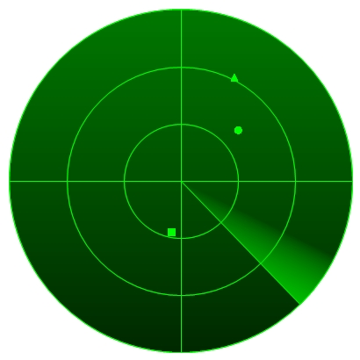
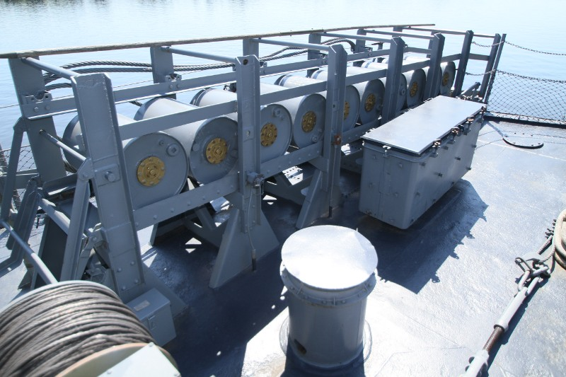
I. Battle of the Atlantic
A. German submarines sinking US ships
1. Convoy system to protect
2. New techs to locate/sink U-boats
a. sonar, depth charges, Enigma
Notes:
Convey system: surround troop/supply ships with multiple rings of warships. Keeps important stuff safe from u-boat attacks. Allows us to get more men/supplies to European front.
New tech:
Radar: helps spot enemy planes
Sonar: radar for the water (spot enemy ships/subs)
Depth charges: barrels in picture. Like underwater grenades. Sub killers.
Enigma: machine by which we broke German naval code, so we could read their mail without them knowing it.

Slide 51
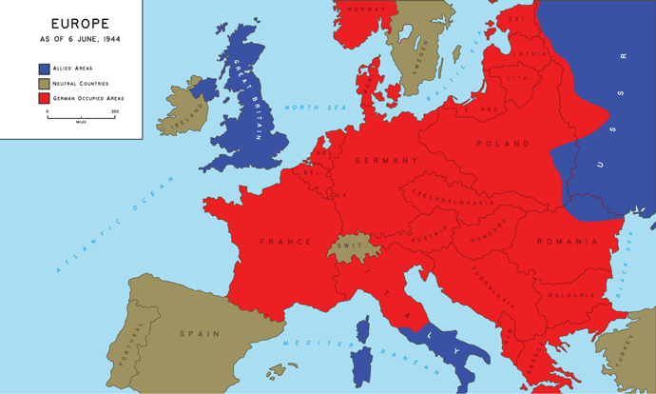
II. Allied Strategy
Take Italy first
Weakest part of Europe
Tehran Conference (Nov. ‘43)
Squeeze Germany from 3 sides
Dismantle a defeated Germany
Soviets will help US fight Japan
Notes:
Most important thing decided at Tehran was that the Allies would FOCUS MOST ATTENTION on Europe and Hitler, defeat him first, then everybody turns attention to Pacific and beating Japanese. So until Europe is won, we are fighting Japanese basically by ourselves while also helping in Europe. We also start to butt heads with Soviet Union here.

Slide 52
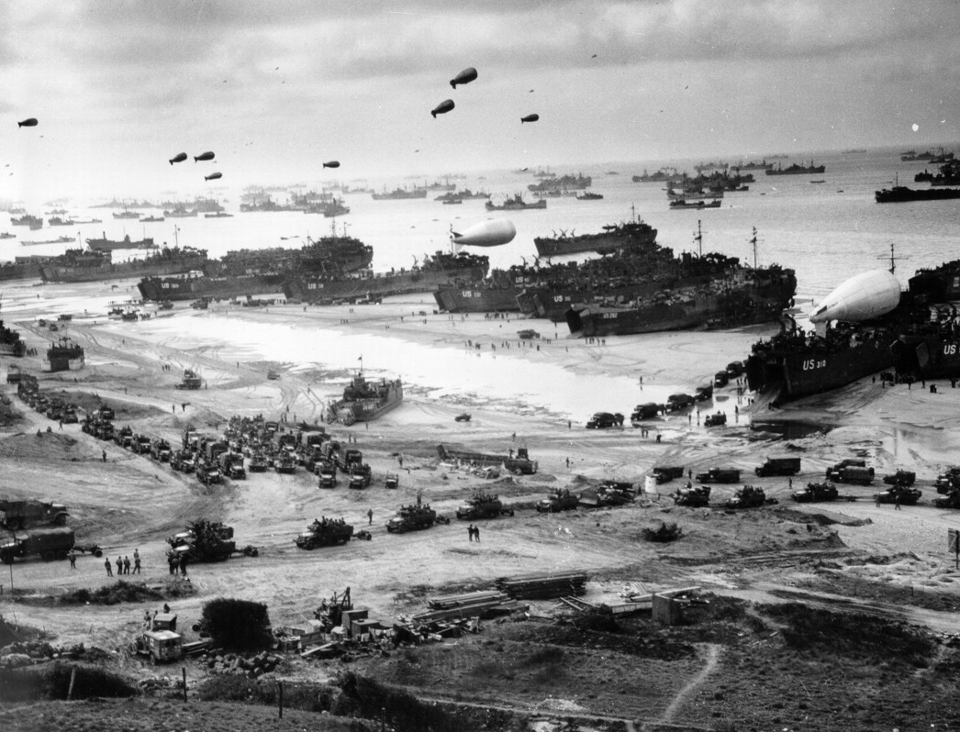
D-DAY INVASION: OPERATION OVERLORD
Notes:
This was US/British opening of a western front in France.

Slide 53
Notes:
Map shows Great Britain (top) and France (bottom), which is where the Allies would go for the D-Day (Normandy) invasion. Normandy is the region of France where the D-Day invasion landed. (went from GB to France across English Channel)

Slide 54
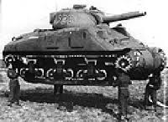
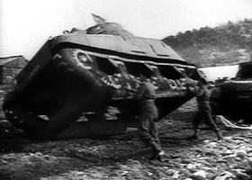
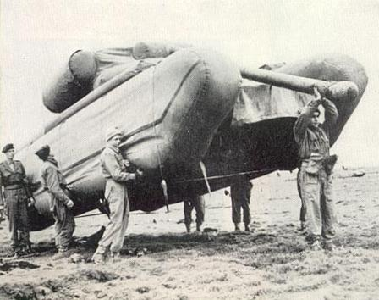
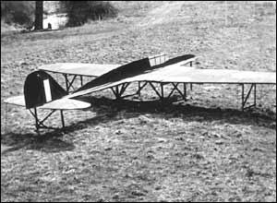
Operation Fortitude (decoy)
Notes:
Operation to trick the Germans into thinking invasion was coming to Calais (see map on previous page) but in reality, we were going to Normandy

Slide 55
III. D-Day
JUNE 6, 1944
A. 4,000 Allied ships carried the invasion force of 156,000
1) landed on beaches in the Normandy region
2) Over 2,500 Allied troops died on D-Day and
another 7,500 were wounded.
B. Opened up western front, took pressure off USSR and led to Germany’s retreat & eventual defeat

Slide 56
D-DAY
Notes:
Look at this full screen to see more pix, maps of D-Day

Slide 57
Fighting in the Pacific

Slide 58
CONCEPTS
US didn’t need to take EVERY Pacific island, just those with deep-water ports or big enough for airfields for Naval use. So they island-hopped, working way closer to Japan. Coral Sea and Midway were the two key battles of the Pacific theater.
Island hopping
Battle of Coral Sea
Battle of Midway
KEY TERMS

Slide 59
Pearl Harbor Recap
21 of 96 ships were sunk. Most others were damaged. Eight battleships sunk or out of commission.
347 of 394 planes destroyed or damaged
2,403 dead; 1,178 wounded
BUT
Carriers were out to sea (Lex, Enterp, Sarat)
Sub pens untouched
Fuel oil depots unharmed
Signals intelligence unharmed
Notes:
Self explantory

Slide 60
Japanese Strategy in Pacific
Notes:
Initially going south until doolittle raid. Feared bombs could kill emperor, so went with yamamoto’s plan to capture midway and draw rest of US navy into battle where they could be destroyed.

Slide 61
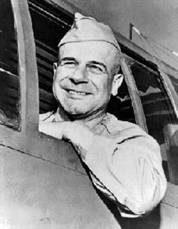
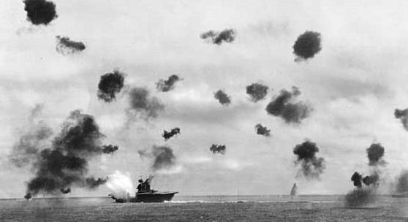
I. Turning Back Japan
A. Change in Japanese strategy
1. After Pearl, wanted to take
Australia and South Pacific
2. Doolittle Raid changed that
3. Now, destroy rest of US Navy at Midway
B. Battle of the Coral Sea (May ‘42)
1. Japanese code broken
2. 1st US win in Pacific
James Doolittle
Notes:
Japanese had originally planned to not worry about US after Pearl, thinking we would be on our heels. Instead they planned to sail South and cut off Australia from outside help, take over that country and have solid control of the Pacific.
Doolittle Raid changed that strategy. Japanese felt they now had to worry about US and concentrated on Midway Island, which was the other major US outpost in the Pacific.
First US win in the Pacific came in the south pacific at a chain of islands north of australia called the Coral Sea.

Slide 62
II. Turning Point: Battle of Midway
A. June 4, 1942
1. Island was only US stronghold
2. Japanese lost 4 largest carriers
a. Heart of their fleet
3. Japs play defense for next 3 years
Notes:
Turning Point battle for the Pacific. In this battle, the US sank 4 of the 9 aircraft carriers in the Japanese navy. This marked the end of Japanese expanding control in the Pacific. From this point forward, US would be pushing Japanese back toward their “home islands”.

Slide 63
Japanese Strategy in Pacific
MIDWAY ISLAND

Slide 64
Ending the War

Slide 65
CONCEPTS
US had to choose between sacrificing millions of soldiers with land-invasion of Japan or dropping the atomic bomb. A-bomb was controversial b/c it would kill hundreds of thousands of civilian non-combatants. But Truman decided lives of US soldiers were worth more than Japanese civilians.
Manhattan Project
Potsdam Conference
Hiroshima and Nagasaki
KEY TERMS

Slide 66
Notes:
Home islands of Japan

Slide 67
Chapter 27, Section 5

Slide 68
Island Hopping in the Pacific
Chapter 27, Section 5

Slide 69
I. Defeating Japan
A. Battle for Iwo Jima (Feb. ’45)
1. close to Japan for bombers
2. 6,800 Marines died in victory
Notes:
Iwo Jima was the bloodiest battle of the Pacific. Huge losses for the US, but had an airfield and was close enough to Japan to launch bombers and get them back on the ground safely.

Slide 70
I. Manhattan Project
1. US project to develop the atom bomb
2. Einstein, Oppenheimer
3. Oak Ridge, Tn
Los Alamos, NM
Notes:
Okinawa was going to be the base of operations for an invasion of Japan.
Manhattan Project: code name for the US development of the atomic bomb, led by Albert Einstein’s and Robert J Oppenheimer. Oak Ridge, Tennesse and Los Alamos, New Mexico were the main research centers. Los Alamos was a testing center.

Slide 71
II. Dropping the Bomb
A. Drop it or not?
1. Invasion will = massive casualties
2. March ’45: Napalm Tokyo
3. Potsdam Declaration (7/26/45):
a. Surrender or face “prompt and utter
destruction”
4. Aug. 6, 1945: Enola Gay drops bomb
a. Hiroshima (Little Boy)
b. 80k killed, many more die later
5. Aug. 9: Bombing of Nagasaki (Fat Man)
a. 40k killed
6. Aug. 14: V-J Day
Notes:
We did NOT want to invade Japan b/c it would cost an estimated 1 million US lives.
Potsdam Declaration: Made 3 days after the successful test of the atomic bomb in new mexico. Was a warning to Japan to surrender or face “prompt and utter destruction.” Japanese ignored it.
Hiroshima and Nagasaki chosen as targets for the bombs b/c they were industrial cities that produced war goods. Also, relatively small, so human casualities wouldn’t be in the millions.
After dropping bomb named “Little Boy” on Hiroshima, gave Japanese three days to surrender before hitting Nagasaki with “Fat Man” bomb.
Second bomb did trick, forcing Japan to surrender. Aug. 14 known as V-J Day, or Victory in Japan Day, marking the end of WW2.

Slide 72
Notes:
Pictures of the bomb and damage done. Look at full screen. Shows before-After

Slide 73
Japan Surrenders
Notes:
Full screen for pix of end of war

Slide 74
Check for Understanding
3. What was the reason for the decision to drop the bomb?

