Slide 1
Nixon and Foreign Policy

Slide 2
I. A New World
5 superpowers
US, USSR, China, Japan, Euro Econ Community
USSR & China not getting along (’69)
Realpolitik
Alliance basis → national interests
Not world views/politics
Friends if we benefit regardless of their views
Notes:
Realpolitik was major change in our approach. Before our foreign relations with countries depended on their politics (commie or anti-commie) and kept us from relations with communist nations. Realpolitik was about how much power another country had and if they could somehow benefit the US politically or economically. Basically, if you were a powerful country, we’d deal with you. if you weren’t, we didn’t really care.
How would that have changed our involvement in Vietnam?

Slide 3
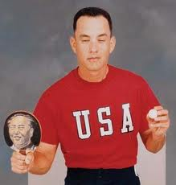
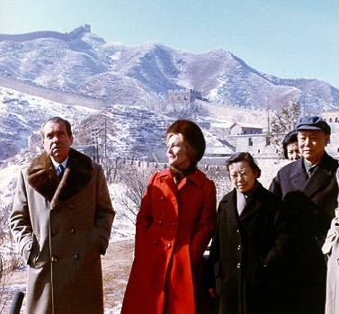
II. China Relations
Why?
Vietnam impact (failed)
Bigger divide w/ USSR
Ping Pong Diplomacy (April ‘71)
End trade embargo
Nixon visits (Feb. ’72)
1. Makes USSR jealous, worried
Notes:
Why did we want to be friends with China? We thought they’d stop supporting N. Vietnam (didn’t happen) and we wanted to break up their closeness with USSR, which had already started. We didn’t want the world’s two largest commie nations to be friends.
First attempt at better relations was when we went the US ping pong team to China to play good-will exhibition matches (see Forest Gump). That ended with us restarting trade with China, which had ended in 1949 when commies took over.
When nixon visited, it really calmed down cold war fears with China. Plus, it made USSR worried that we were becoming close and they didn’t like that. They could benefit from good relations with us, so they got a little worried and extended invite to Nixon to visit Moscow.

Slide 4
Notes:
Mr. and Mrs. Nixon at Great Wall of China with leader of China and his wife

Slide 5
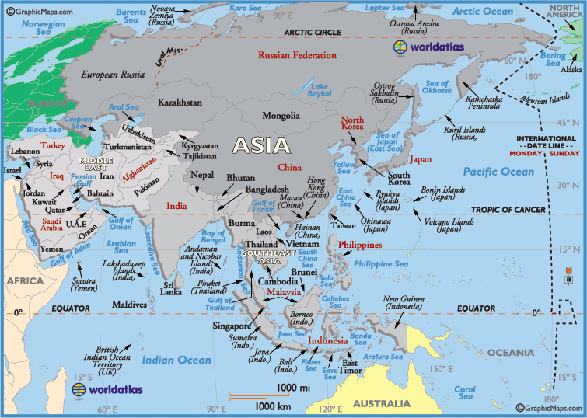

Slide 6
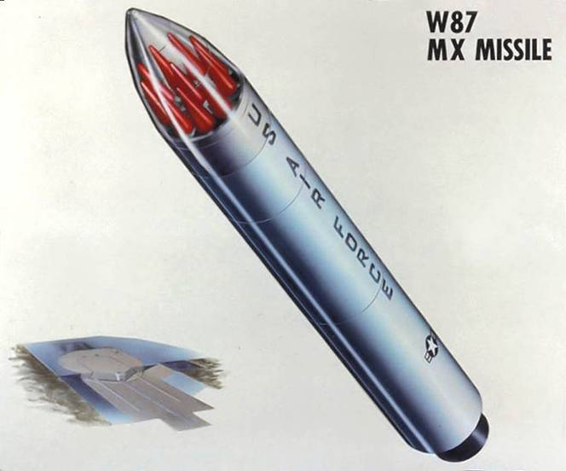
III. Soviet Relations
May ‘72: Nixon 1st Prez to visit Moscow
Soviet reasons 2 be nice
Slow US-China alliance
Stop costly arms race
US tech & grain
SALT I
Nuke limit
More symbolic than
anything
Notes:
Basically, slide is self-explanatory. #3 under B., soviets could really use access to some of our technology from farming to increase their production, plus they could really use a nation that could sell them large amounts of grain.
SALT I limited number of nuke weapons both sides could produce, but only a specific type of weapon, which wasn’t in large production anyways. More symbolic treaty than one that really did anything b/c we kept building our main type of nuke missile, seen in picture, which had massive destructive power.

Slide 7
The Carter Years (1977-1980)
Foreign Policy and Energy Crisis

Slide 8
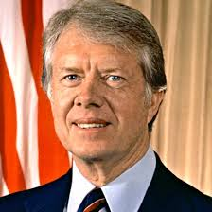
I. Human Rights basis
Wouldn’t support nations that violated human rights
Agreed to give up Panama Canal (did in 1999)
Ended Détente w/USSR and China
1. Oppressive gov’t that denied citizens rights
Notes:
Jimmy Carter based his foreign relations on whether countries had good track record with human rights. Human rights means treaty their people with respect. If you didn’t, we weren’t going to be friends with you. This strained relations with USSR and China, both of which were harsh dictatorships that squashed opposition among their citizens very quickly.
Carter also was the Prez who gave away control of the Panama Canal with an agreement in 1978. We would hand over control in 1999 (which we did). Did improve Latin American relations b/c it was a sign that we weren’t going to control smaller countries quite so much as we had in past.

Slide 9
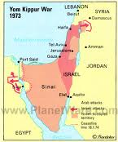
II. Middle East Relations
Camp David Accords (Summer ‘78)
Peace between Israel and Egypt
a. Israel leaves Sinai Penisula
Egypt recognizes Israel’s
right to exist
Avoids war that could
have started WW3.
Notes:
Carter’s biggest win was mediating a peaceful resolution to a long-time hatred between Israel and Egypt. Israel in the Yom Kippur War during 1960s had gained control of the Sinai Peninsula (see map) which had been part of Egypt since the time of the Pharoahs. Egypt wanted it back and war was brewing. Carter invited leaders of both countries to meet with him at Camp David (the presidential retreat in Maryland) and worked out agreement as outlined on slide.

Slide 10
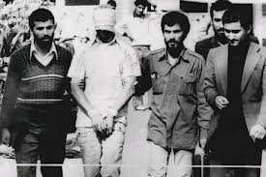
B. Iran Hostage Crisis (1979)
1. Islamic revolution in Iran
2. College students overrun, capture US
Embassy in Tehran, holding 52 people
hostage
3. demand return of the Shah in exchange for
releasing hostages
a. Shah: former Iranian leader, in US for cancer
treatment as well as protection.
4. Hostages released in Jan. 1981, days after
Reagan becomes President.
Notes:
Carter couldn’t gloat long though, because he ran into the Iran Hostage crisis. Slide pretty self-explanatory.
Reason students overran our embassy: The former leader, the Shah, was a bad dude, but he was anti-commie and sold us oil cheap, so we liked him despite how he treated his people (even Carter was OK with him b/c $$ means more than human rights). When Shah was overthrown, we allowed him to come to US for “cancer treatment”. Iranians demanded he be returned to face trial and execution. We said no. Crap then hit the fan.
Ben Affleck movie “Argo” centers around this event and 6 Americans who escaped before students were able to lock down the Embassy workers.

Slide 11
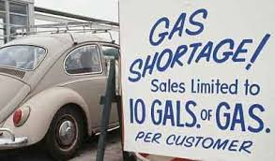
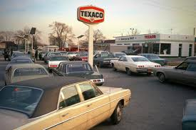
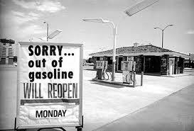
III. Energy Crisis
OPEC had raised prices since 1960s.
Price quadrupled in 1974
B. Led to gas shortage and long lines
C. Carter encouraged Americans to cut oil
consumption.
Notes:
This was a big hit to Carter’s chances of being re-elected in 1980. not only did we had trouble getting affordable gas out of Middle East, but Carter put lot of regulations on domestic oil production (think Texas and Alaska) due to environmental concerns.

Slide 12
Reagan and End of Cold War
Plus George Bush Sr. years

Slide 13
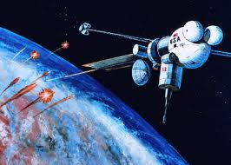
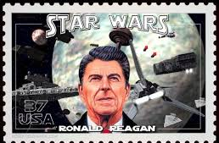
I. Strategic Defense Initiative (SDI)
More commonly known as “Star Wars”
Space-based missile defense system (would have cost TRILLIONS)
Never materialized, but got Soviets panicked, so they started spending money like crazy.
Notes:
This was Reagan’s big military thing. We started research and planning on it, but it turned out not be feasible to actually institute it (monetarily and technologically), but Soviets found out about it, thought it was going to happen, so started spending $$$ like crazy to improve their defenses, which would lead to HUGE economic problems for them, which would greatly contribute to collapse of communism.

Slide 14
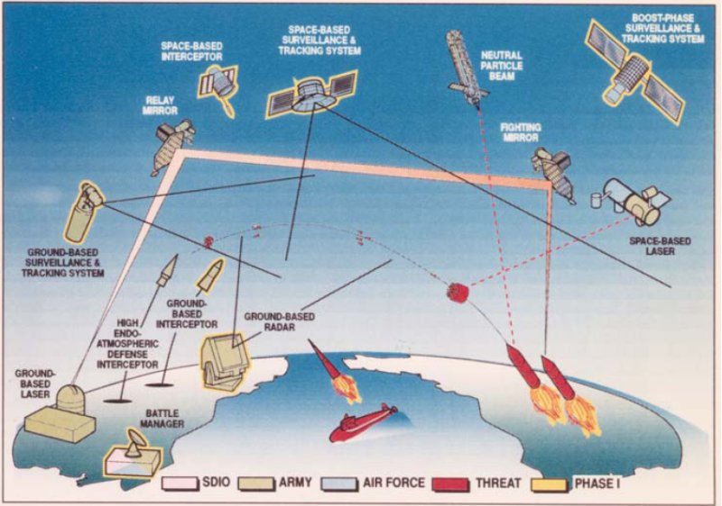
Notes:
Fancy graphic showing what SDI would have looked like and worked

Slide 15
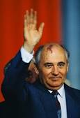
II. Cold War Ends
A. Glasnost and Perestroika → democratic ideals
that led to communism collapsing in USSR
B. Mikhail Gorbachev: Soviet leader who
oversaw breakup of USSR.
C. Why? Economy was terrible
1. Defense spending too much
2. Too costly to support satellite nations
3. Communist economy just can’t grow
Notes:
Glasnost: USSR leader Gorbachev’s allowance of open criticism of Soviet gov’t and move toward free press. Huge deal b/c before, anyone who criticized ended up in prison or dead.
Perestroika: plan to move from communist economy (where gov’t controls everything) to more free enterprise (like we have, where biz is owned privately and gov’t doesn’t control it) as well as moving toward a democratic gov’t instead of a dictatorship.
Satellite nations put strain on USSR econ b/c USSR had to financially support them. Remember, Communism is not a growth economy, so smaller countries have trouble supporting themselves.

Slide 16
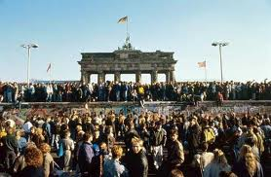
II. Satellite Nations Cast off
1988: Gorbechev tells satellites to go on their
own, pursue democracy
1. withdrew USSR troops, allowed non-commie
political parties to form
B. Oct/Nov. 1989: East Germany goes democratic
1. Nov. 9, Berlin Wall gates opened, wall begins
to be torn down.
2. Oct., 1990: Germany reunites as 1 country
Notes:
As a result of the financial burden of satellite nations, Gorby told them to go on their own, change to free enterprise and democracy and stop being a rock pulling the USSR econ into the crapper.
In greatest sign of collapse of communism in Europe, East Germany goes democratic and opens border crossings between East and West Berlin. In days and weeks following this announcement, people of Berlin literally start tearing down the Berlin Wall. Other than 9/11, most important world event in the past 40 years.

Slide 17
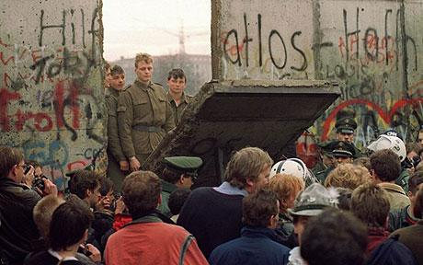
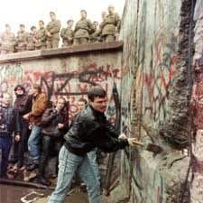
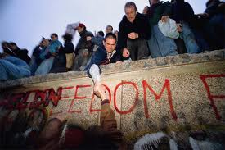
Notes:
Pictures of Berliners attacking the wall after communism collapses in East Germany.

Slide 18
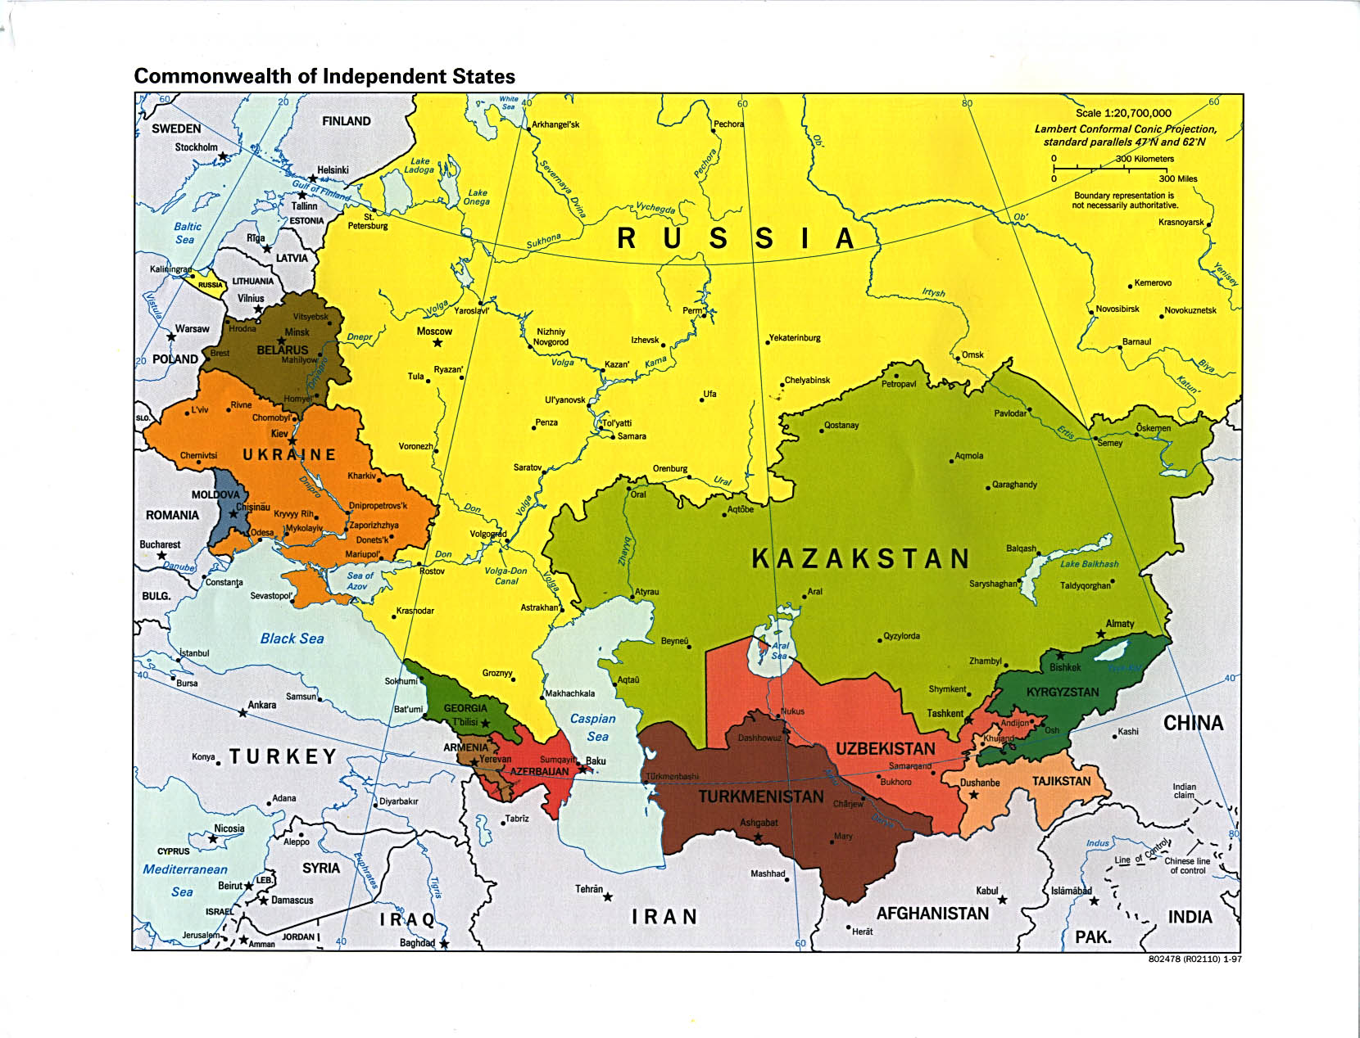
III. Break-up of Soviet Union
A. Dec. 1991 → 14 Soviet states declare independence.
Notes:
Map shows Russia and then the other newly independent countries that had made up the Soviet Union.

Slide 19
IV. Latin American Relations
Still fighting communism b/c of Cuban influence.
1. Nicaragua
2. Grenada
B. Took out Noriega in Panama
1. Drug lord, part of Reagan’s War on Drugs
Notes:
Slide self explanatory. Nicaragua is in Latin America, down by Costa Rica. Grenada is a tiny island in eastern Caribbean.

Slide 20
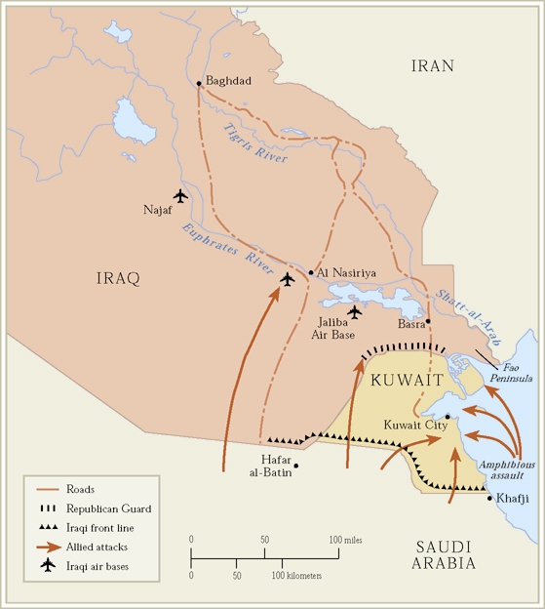
V. Gulf War of 1991
Iraq invaded neighboring Kuwait (oil-rich)
US goes in to free Kuwait
5 weeks of sustained bombing off Iraq forces
Ground war lasted 100 hours before Iraq pulls out.
** Establishes our ongoing intervention in Middle East affairs, focusing on oil.
Notes:
Slide self-explanatory

Slide 21
21st Century Issues
Terrorism, Trade and Immigration

Slide 22
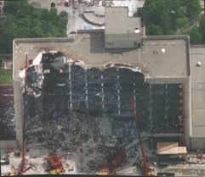
I. The War on Terror
Sept. 11 wasn’t first blow to America
1993: Car bomb in World Trade Center
1995: Oklahoma City bombing (168 dead)
a. Timothy McVeigh, Gulf War Vet
Notes:
Self-explanatory. Examples of pre-9/11 terrorist attacks in US. First WTC was done by islamic terrorists. OKC bombing done by a crazy American, so don’t think that only muslims can be terrorists.

Slide 23
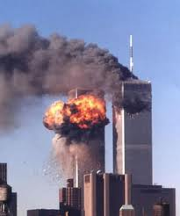
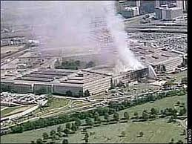
B. Sept. 11, 2001
1. WTC, Pentagon hit with planes.
2. Led to official “War on Terror” in Middle East
a. Afghanistan → al-Qaeda & Taliban
b. Iraq → Saddam Hussein and WMDs (?)

Slide 24
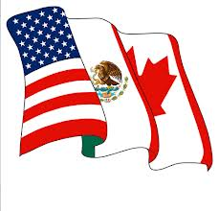
II. Trade and Globalization
Trade is key to US and global economic stability.
NAFTA → North American Free Trade Agreement
US, Canada and Mexico
Removed most barriers to trade between 3 nations
Supporters: strengthen econ and create US jobs.
Opponents: allows US companies to
move factories/jobs to Mexico
w/out penalty.
Notes:
Self-explanatory

Slide 25
III. Immigration Issue
Pre-1900 immigrants from Europe
Since 1960, 80% from Latin America or Asia
50% from Latin America, 30% from Asia
Coming for jobs
Majority-minority states: places where minorities account for majority of population. Cali, NMex, Hawaii
Illegals are big issue → 11 million by 2009
Notes:
Self-explanatory

Slide 26
IV. Proposition 187
California law passed in 1994
Cut all education and nonemergency health benefits to illegal immigrants.
B. Struck down by US Supreme Court in 1998
1. Said only Fed Gov’t could pass immigration laws.
2. Also violated 14th Amendment right to due
legal process b/c allowed expulsion without
a hearing.
Notes:
Self-explanatory

