Slide 1
CRM: The 1960s

Slide 2
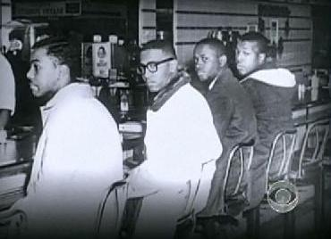
I. Sit-in Movement
Started in Greensboro, N.C. (SNCC) with 4 students at Woolworth’s lunch counter. Whne they were refused service, they wouldn’t leave. Came back next day and did it again, with even more of their friends. Movement grew across country. They were non-violent, even when attacked

Slide 3
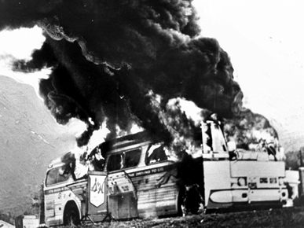
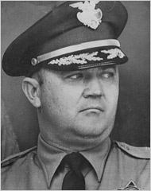
II. Freedom Riders (May ’61)
This group of mostly college students were protesting interstate bus segregation. They would board busses in North and ride into South where Jim Crow Laws provided for segregated waiting rooms at bus terminals.
Event came to a head in Birmingham, Ala. There a mob was awaiting the Freedom Riders at the bus station and attacked/beat them. No cops were around. When asked why he had no police there knowing that the Riders were coming, Commissioner of Public Safety Eugene “Bull” Connor said he’d given them the day off to spend with their mothers (Mother’s Day). I reality, he had arranged for the mob and beatings.

Slide 4
Challenging Segregation
1960-1966

Slide 5
JFK and Civil Rights
The Black vote was crucial to his election and he had made promises to push for civil rights, but he backed off knowing he’d need support from Southern Senators for other issues, namely Cold War problems with Russians.
He did, however, appoint 40 African-Americans to high-ranking gov’t jobs
Also established the Committee on Equal Employment Opportunities (CEEO), which forbade discrimination on racial basis in hiring or promoting people for Federal jobs.

Slide 6
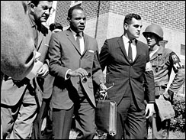
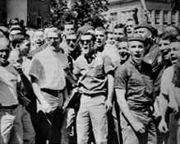
James Meredith became important figure when he integrated the University of Mississippi. He transferred to the bastion of white education for his senior year. Would need federal body guards to accompany him on campus, but did graduate

Slide 7
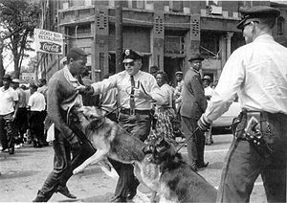
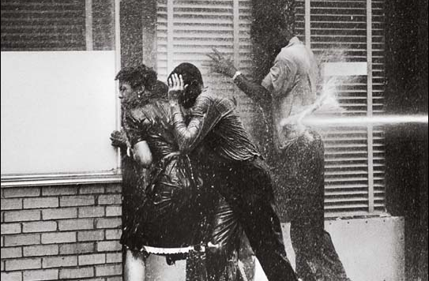
Birmingham, Spring of ‘63
MLK went there to lead a protest march but was arrested by Bull Connor.
Writes a “Letter From a Birmingham Jail” in which he explains the plight of the civil rights protestors and the injustice of Jim Crow. Gains a lot of support from around nation.
King is eventually released and leads the protest march and Connor orders the marchers beaten. Media coverage is extensive and causes outrage against southern laws and gives JFK the opportunity to order the writing of a civil rights bill.

Slide 8
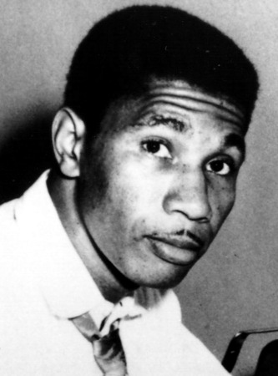
Announcing CRA of 1964
Civil Rights bill is written, but Kennedy needs another event to spark outrage in order to announce it and keep southern opposition at a minimum. This happens when a black student attempts to enroll at U. of Alabama. Governor George Wallace physically blocks the doorway to admissions office before being removed by law enforcement. The next day, in retaliation, the KKK murders NAACP lawyer and activist Medgar Evers. JFK then announces the CRA.
King and the SLCC organizes the March on Washington for Aug. 28, 1963 to pressure Congress to approve the Civil Rights Act. Over 200,000 whites and blacks show up to support the CRA. It is here that King delivers his famous “I have a dream” speech.
Evers

Slide 9
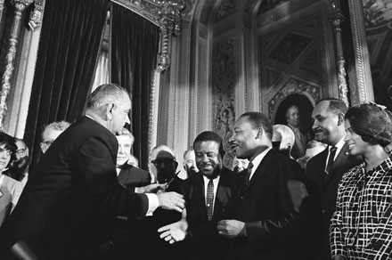
Civil Rights under LBJ
The Civil Rights Act of 1964 declared segregation in public facilities illegal & officially ended the majority of Jim Crow laws

Slide 10
Civil Rights under LBJ
Civil rights groups were not content & continued for equality:
Freedom Summer in 1964 led to the registration of thousands of Mississippi blacks to vote
The 1965 protest march from Selma, Alabama to Montgomery led to police violence; “Bloody Sunday” shocked people in the North more than any other event

Slide 11
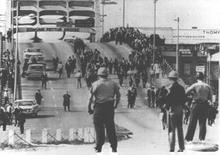
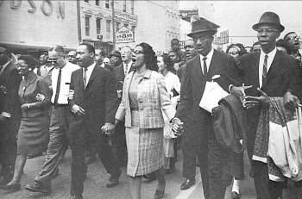
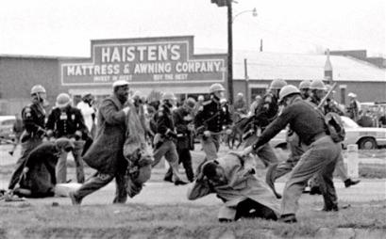
Selma, Alabama (1965)

Slide 12
Civil Rights under LBJ
After the Selma march, LBJ & Congress passed the Voting Rights Act (1965)
Banned literacy tests & sent federal voting officials into the South to protect voters
The act finally accomplished what Radical Republicans had envisioned when the 15th Amendment was enacted in 1870

Slide 13
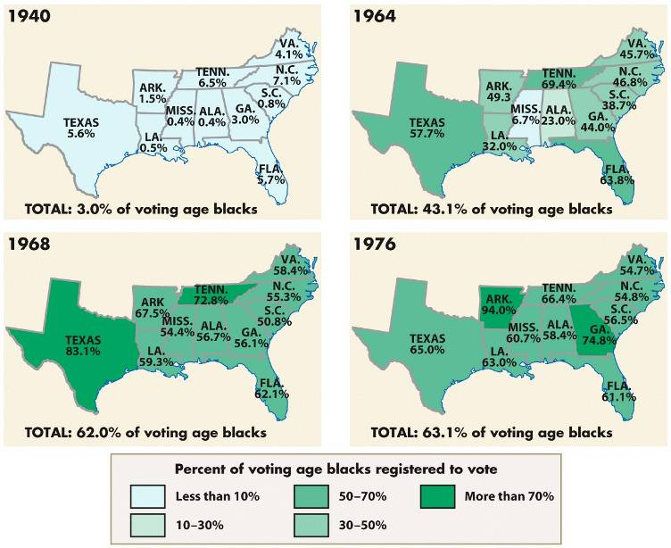
Blacks became a voting force in Southern politics for the 1st time since Reconstruction

Slide 14
Conclusions
The Civil Rights movement of the 1950s & 1960s finally brought black Americans political equality
The fight for social & economic equality saw a departure from nonviolent protest to a more radical movement in late 1960s
Black civil rights success inspired other groups to strive for equality

Slide 15
New Issues
1965-1969
Be peaceful, be courteous, obey the law, respect everyone; but if someone puts his hand on you, send him to the cemetery.
-- Malcolm X

Slide 16
Achievements by ’65 in civil rights
Segregation now ruled illegal in most areas of public life.
Voting rights for AA’s strengthened. No more poll taxes, literacy tests, etc.

Slide 17
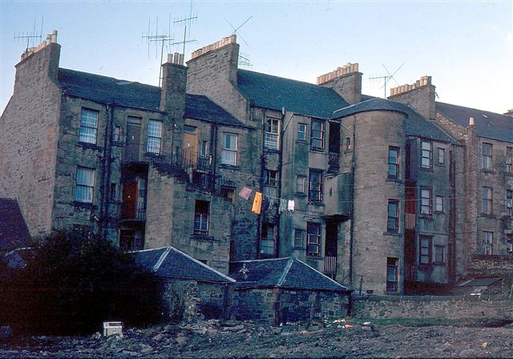
Challenges Remain
Racism alive and well and the movement thus far had done little for the economic situation of African Americans
Housing and employment was still a major problem and half of all African Americans lived in poverty. In the inner cities, crime and juvenile delinquency were on the rise

Slide 18
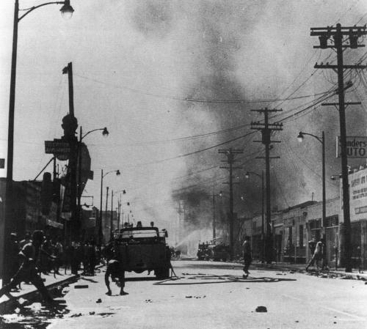
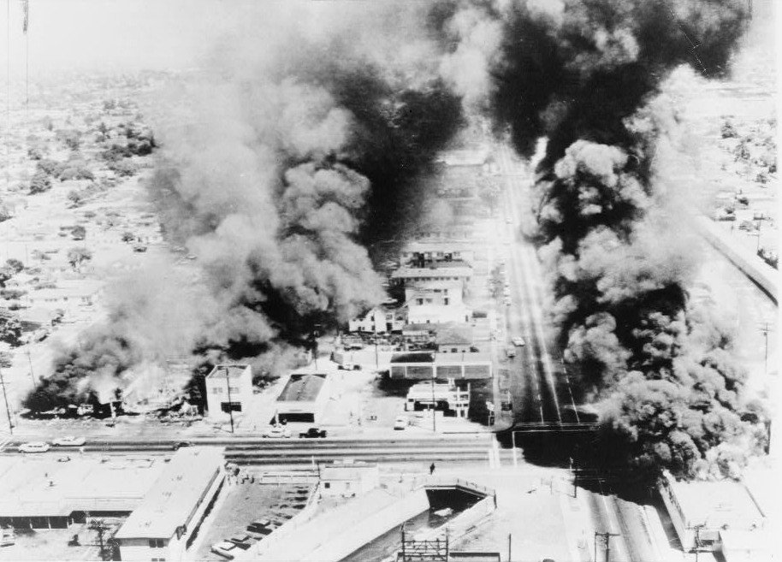
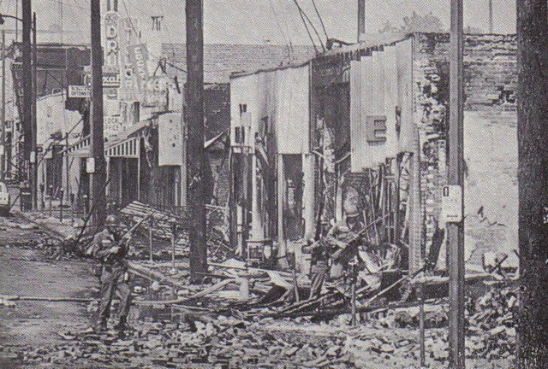
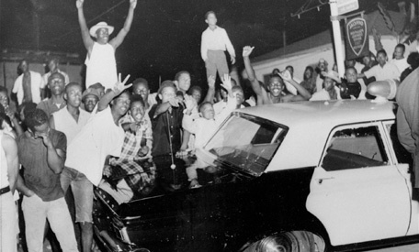
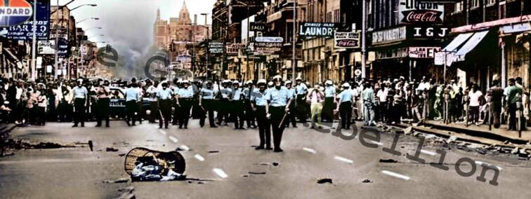

Slide 19
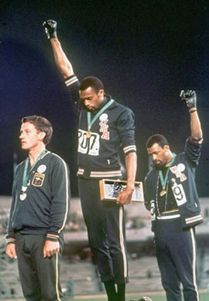
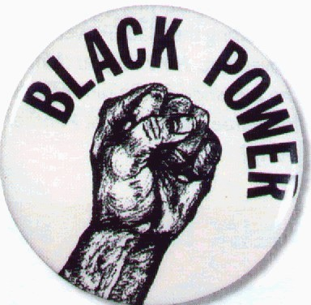
Black Power Movement
Garvey-esque in belief that African Americans should control the social, political & economic direction of the struggle. Promoted pride in being black, rejection of white society and embracing of racial distinctiveness.
Became very popular in inner-city
Broke with belief in non-violence
OK in self-defense
Believed MLK and his coalition with white leaders were not doing anything to help them.

Slide 20
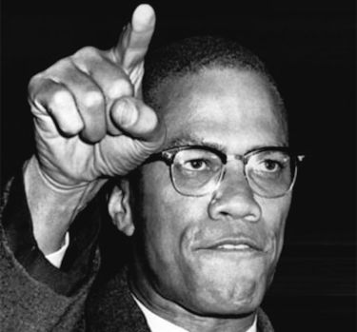
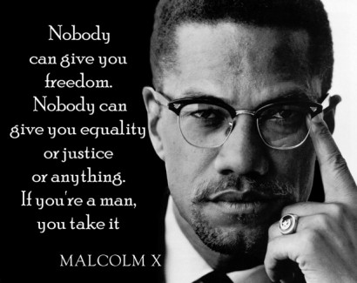
Malcolm X and Nation of Islam
1. Anti-white
2. “X” stood for slave family
3. Black Muslims preached black
nationalism; separate black society
4. black community self-sufficient
5. 1964: Malcolm leaves Nation of Islam
a. Feb. ’65: killed by Black Muslims

Slide 21
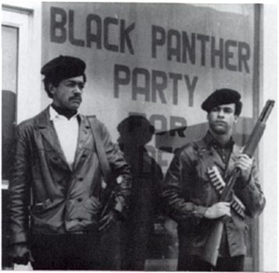
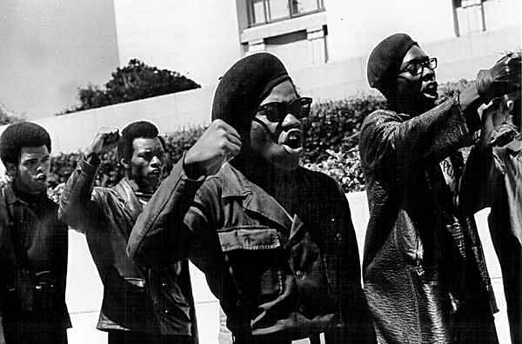
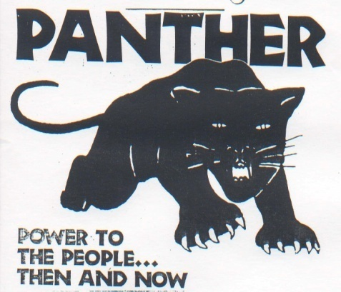
Black Panthers
Militant organization formed in Oakland, Calif. Believed revolution is necessary and said they wanted to arm blacks and force whites to give whites.
“Ten-Point Program”: black empowerment, end racial oppression, control services in black community.
Lot of talk and attention b/c of the radical threat, but never really started any trouble. Lot of good for the local community in Oakland, though.

Slide 22
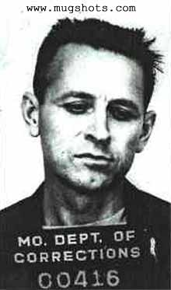
MLK Assassinated
Memphis, Tennessee, April 1968
King there to support sanitation strike and launch campaign to get billions of gov’t dollars to help end poverty
He was shot standing on hotel balcony by James Earl Ray.
His death left movement with lack of
unity and vision. Steps forward would
be fewer and farther between.

