Slide 1
Economic Systems
Chapter 2

Slide 2
Section 1: Answering the 3 Economic Questions (add A&B supporting details)
According to the text, the function of an economic system is to produce and distribute goods and services.
The three key economic questions are: what goods and services should be produced? How? and for whom?
Societies determine how to answer the 3 questions based on a combination of values and goals.
The main goals economic systems use include: efficiency, freedom, security, equity, and growth.
A safety net is a type of government program for protection of people against unfavorable economic conditions.
The 4 economic systems are: traditional, free market, centrally planned (aka command), and mixed.

Slide 3
DEAR ABBY: Please reprint the forms of government you had in your column a few years ago. I believe there was something about a cow in the explanation.
COMMUNISM: You have two cows. The government takes both of them and gives you part of the milk.
SOCIALISM: You have two cows. The government takes one and gives it to your neighbor.
FASCISM: You have two cows. The government takes both cows and sells you the milk.
NAZISM: You have two cows. The government takes both your cows, then shoots you.
BUREAUCRACY: You have two cows. The government takes both of them, shoots one, milks the other, then pours the milk down the drain.
CAPITALISM: You have two cows. You sell one of them and buy a bull.

Slide 4
Section 2: The Free Market
Markets exist because buyers and sellers need to exchange goods and services.
Specialization is necessary because it makes production more efficient and no one is self-sufficient.
Use the figure 2.2 on pg. 31 to answer the following questions:
What does the figure as a whole represent?
What does the upper half represent?
What does the lower line of monetary flow show?
The product market is when households purchase goods/services from firms.
The free market philosopher that published The Wealth of Nations was Adam Smith.
The motivating force behind the free market is self-interest.
Profits are the incentives that motivate a manufacturer to sell a product.
Competition is the struggle among producers for the consumer’s business.
For a free market economy, the goals that help to define it include efficiency, freedom, growth and consumer sovereignty.

Slide 5
Section 3: Centrally Planned Economies
According to the three key economic questions the characteristic of a centrally planned economy is centralized government makes all decisions.
Socialists believe wealth should be evenly distributed so the government controls the centers of economic power though socialism uses both government planning and individuals to answer the key questions.
Communist is an extreme form of socialism, but unlike socialism, communists are authoritarian (“requiring strict obedience to someone such as a dictator”). Socialism can coexist with free market.
Vladimir Lenin was the leader that introduced communism and central planning to the former Soviet Union. But it was Stalin that imposed the strict plans that boosted the economy.
The main problems consumers of centrally planned economies encounter includes shortages and low quality goods. Usually because government focused on heavy industry (trade off).

Slide 6
Section 4: Modern Economies
There very few “pure” economies because pure economies do not meet the needs of the society.
Markets need some government intervention since some needs are better achieved through government action.
Laissez faire is the doctrine that government should not interfere with the economy but there are limitations.
In a mixed economy, the government’s role in the product market includes purchasing goods/services to make the government run; the factor market, they employ workers.
An economic system characterized by private or corporate ownership of capital goods is free enterprise.
A continuum is used to show the range of combinations of free market and centrally planned systems.
If a country is said to be in transition, it means it is moving from one economic system to another.

Slide 7
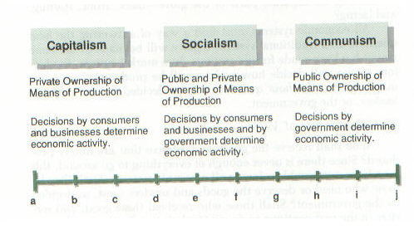
No country has an economic system that is 100 percent communism, socialism, or capitalism. All countries today have mixed economic systems or mixed economies, with some free enterprise and some government ownership.
In the U.S., as in most capitalist countries, there are many examples of government ownership. Public colleges, high schools, and elementary schools, for example, are owned and operated by state or local governments. Other publicly owned enterprises are the postal service, many municipal bus lines and trains, a few electric power plants, and housing projects.

