Slide 1
Note to home viewers!
Do not look at this “full screen”, keep it in “window” view so that you can see the white box below that says “click to add notes”.
There are expansive notes for the final slide, “Life under slavery”

Slide 2
Ch. 11 Notes
Women and Slaves
in Antebellum America

Slide 3
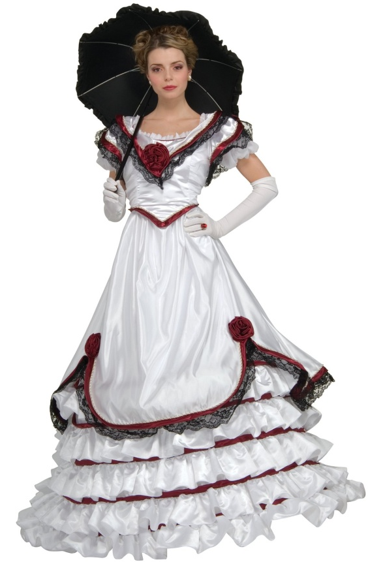
I. Comparing Women: North and South
Similarities
“Southern Ladies” and middle class North: Centered on the home. Raising kids; taking care of husbands.
Differences
Cult of honor: SW more commonly dominated by men.
SW birthrate 20% higher
SW 25% over 20 yrs old: completely illiterate. Education opps scarce
SW lived in isolation (farms spread out). Few opps to explore beyond being wife/mother.
NW more freedom b/c production had moved outside the home.
Some SW were strictly arm-candy for husbands
SW suffered through cheating hubbies, who had affairs w/ slaves
SW accepted role under belief they were lucky to have good things they got.

Slide 4
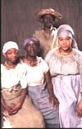
II. Myth of commonality of slavery
Owners <25%
Planter domination made seem more
Widespread support
Non-slave owners ties
Family
Financial support
Democratic values
Loyalty to “Southern way”
-- Poor whites: sense of superiority

Slide 5
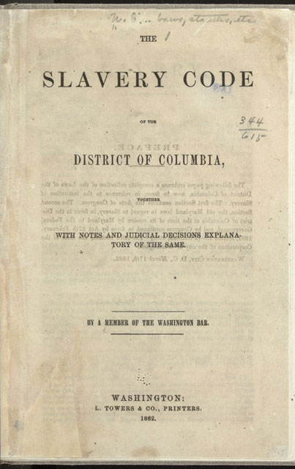
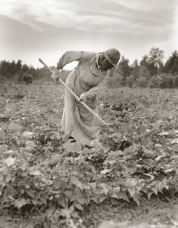
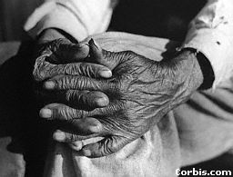
III. Life under Slavery
Slave codes
Paternal relationship
Working conditions
High mortality rates
Cities: more autonomous
Resistance: sambo vs. rebel
Notes:
Slave codes
Why was slavery called the Peculiar Institution?
Other than Brazil, Cuba and Puerto Rico this was the only place it was going on
Isolated from the rest of american society
African Americans developed a distinct culture
Whites and blacks influenced each other
What were some of the slave codes?
Slaves cannot hold property
Cannot leave master’s property without permission
Cannot be out after dark
Cannot congregate except at church
Cannot carry firearms
Cannot strike any white people ever
Cannot be taught to read or write
Cannot testify in court against whites
Cannot marry or divorce
Whites not punished for killing slaves
Slaves get death for killing/hurting/revolting against whites
Anyone with any trace of African ancestry defined as blacks.
Read slave
Where these laws enforced?
No it varied widely and most lived with considerable flexibility and autonomy.
Paternal Relationship
Small plantation v large plantation
Small – supervised directly and often worked alongside by masters
Large – more separate and have own social order
Mostly slaves lived on medium to large and were directly supervised by an overseer
Working Conditions
What were meals like?
Simple but adequate
Clothing cheap
Slave quarters – rough cabins
Medical done by mothers mostly sometimes doctors
Work was hard and long and families were split up.
High Mortality rates
As a group far less healthy than southern whites.
After importation was banned in 1808 the proportion of blacks to whites declined as the mortality rate increased.
Why did household slaves have a longer lifespan?
Ate leftovers – better diet
Worked inside
Generally better sleeping conditions
Downside – transgressions were more apparent and they were generally first to leave when emancipation comes.
City autonomy
What advantage did the urban slave have over the plantation slave?
Ability to move around without direct supervision and contact with free blacks and whites.
Resistance
Although many whites tried to say slaves were happy as slaves there is strong evidence to show otherwise.
What were the two extreme responses to slavery?
Sambo – shuffling, grinning, head-scratching, deferential slave acting like he thought he was expected to.
Slave rebel – no acceptance of his condition
While slave revolts were rare the threat was real.
Most famous 1831 Nat Turner in Virginia. He dictates his confession in 1832 to his white lawyer and it becomes a best seller. This led to more rigid laws and enforcement of slave codes.
Running away was a form of revolt and although not greatly successful it was tried by many.
What was the most common form of resistance?
Refusal to work hard
Stealing
Sabotage
Subtle rebellion

